Slide 1
Interdisciplinary Magic
The Balance Between Dependence & Interdependence Across the Subjects
Professional Development Presentation Diana Stein University of Phoenix
ADMIN/525
February 20, 2017
Dr. David Berry
Notes:
The purpose of Interdisciplinary Magic: The Balance between Dependence and Independence Across the Subjects workshop is to model techniques and provide training for formative assessment that you will take back to the classroom and use right away to aid the implementation of our new English Language Arts curriculum, but may be layered with all subjects. Artful Thinking and Visible Learning techniques that promote the 4C’s: creativity, critical thinking, collaboration, and communication (P21, 2017) will be explained as they are integrated into multi-subject curriculum in exciting ways that make learning meaningful for everyone. Evaluating, analyzing, and implementing necessary changes that are identified through feedback become more inclusive with a wider range of ways of soliciting for the results that we targeting. Offering choices to students for the ways to learn, as well as to show what they have learned, will go a long way toward improving learning overall. These options in modes and delivery and discovery of ideas may be communicated with parents, and other significant people in the student’s life, to build on the shared vision of creating thinkers, communicators, and achievers. (CAPE 8)

Slide 2
A G E N D A
{
8:30 – 9:00 Welcome! Settle in with coffee, tea, juice, and yogurt with fruit parfaits 9:00 – 9:20 Snapshot: The Day at a Glance
9:20 – 9:30 Assemble into Two Active Learning Groups
9:30 – 10:45 Artful Thinking (with Group 1) GROUPS ROTATE/Bio Break 10:45 -11:00
11:00 – 11:45 Visible Learning (with Group 1)
11:45 – 12:15 Regroup and Recap: Highlights of the Morning, Caiman Hall 12:15 – 1:00 Hosted Soup, Salad, & Sandwich Bar Lunch in Caiman Hall 1:00 – 2:00 Interdisciplinary Magic: The Balance Between Dependence and Interdependence (VAPA Room)
2:00 – 3:00 Four Keys to Coaching Conversations with Confidence (Caiman Hall, all)
3:00 – 3:30 Recap and Rewind: Coaching 1-2-3 & Closing Activity (Caiman Hall, all)
Notes:
*Please refer to the Appendix after the References slide for a full and detailed list of corresponding activities for the Breakout Sessions listed above.

Slide 3
Interdisciplinary Magic
{
O B J E C T I V E S
Develop routines and skills in and Visible Learning and Artful Thinking to promote self-directed, cooperative, and collaborative students (Focus: Critical Thinking & Behavior)
Understand how to analyze integrated lesson essentials/Layered Learning including design, delivery, assessment, and reflection components to meet the needs of all students by including multiple modalities and Intelligences as aligned to California State Standards and Common Core State Standards (Focus: Curriculum Design, Integration, & Assessment)
Utilize reflection to self-evaluate with clear, measureable goals in mind (Focus: Coaching, Confidence, & Self-Analysis)
Multi-age groups working in parallel become interconnected through performance tasks and hands-on learning experiences.
Notes:
As a result of professional development faculty will be engaged in ongoing reflection, self-assessment, and self-directed change and improvement with strategies for building capacity through systems of support and development, together. At the end of the day, and all of the assessments, it is our passion and our collective expertise that impacts learning results the most. (CAPE 5)
Instructional Leadership OBJECTIVES:
Understand how to analyze integrated lesson essentials including design, delivery, assessment, and reflection components to meet the needs of all students by including multiple modalities and Intelligences as aligned to California State Standards and Common Core State Standards
Develop routines and skills in Visible Learning and Artful including: Reasoning, Questioning and Investigating, Exploring Viewpoints, Observing and Describing, Finding Complexity, Comparing and Connecting
Utilize reflection to self-evaluate with clear targets in mind. What would success look like, sound like, and feel like? How would you know (measure) if your students were successful?
------------------------------------------------------------------------------------------------------------------------------------------------------------------------------------------------------------------------------------------------------------------------------------------
Instructional Leadership Goals Layered into this Professional Development Day of Training:
CAPE 5
Promoting Implementation of K-12 Standards, Pedagogical Skills, Effective Instructional Practices and Student Assessments for Content Instruction
CAPE 6
Evaluating, Analyzing, and Providing Feedback on the Effectiveness of Classroom Instruction to Promote Student Learning and Teacher Professional Growth
CAPE 7
Demonstrating Understanding of the School and Community Context, Including the Instructional Implications of Cultural/Linguistic, Socioeconomic, and Political Factors
CAPE 8
Communicating with the School Community about Schoolwide Outcomes Data and Improvement Goals

Slide 4
A C T I V I T I E S
{
Five activities that encourage reflective practice for each participating teacher:
BREAKOUT SESSIONS
Visible Learning, in Caiman Hall (1:15 minutes) (Appendix A) ACTIVITY: Peel the Fruit
Artful Thinking, in the VAPA Room (1:15 minutes) (Appendix B) ACTIVITY: See-Think-Wonder
Layered Learning Comes Alive (60 minutes) (Appendix C) ACTIVITY: SEE–THINK–WONDER–KNOW?
Four Keys to Coaching Conversations with Confidence (60 minutes) (Appendix D)
Coaching 1-2-3 Closing Activity

Slide 5
The Balance Between Dependence & Interdependence Across the Subjects
(TED Talks, 2013)
Magic
Notes:
Today, Classical Academies’ coaches and lead teachers in all content areas will have opportunities to learn approaches and access tools created by Howard Gardner in conjunction with Harvard’s Project Zero as applied to Artful Thinking and Visible Learning. Additionally, we will explore the work Australia’s own John Hattie with his compelling advice on how to reach and teach all learners. (CAPE 5)
Welcome to Interdisciplinary Magic: The Balance between Dependence and Independence Across the Subjects professional development day. We believe that the purpose of professional development is for both individual and school purposes to strive to meet learning goals as we connect learning opportunities to self-improvement. This requires active and continuous commitment and investment to learning, as our primary focus as educators is to improve teaching and learning for others. (CAPE 6) *Please see: TED Talks. (2013). Every kid needs a champion | Rita Pierson. Retrieved from https://www.youtube.com/watch?v=SFnMTHhKdkw
Our students deserve our very best. Our school-wide learning goals are for each of us to become thinkers, communicators, and achievers; as this will intrinsically promote lifelong learning resulting in positive growth of the community and society as a whole. The foremost goal of this professional development day is empower each of you as you measurably improve teaching and learning for each of our students; this is done by understanding the value of human relationships first. As teachers, administrators, and as caring community members we need to know what’s going on in our student’s lives. If we have an understanding of what life challenges they face, within in and outside of school, we are better prepared to help each child succeed academically as well as socio-emotionally. (CAPE 7)

Slide 6
Together We Are Better.
“Learning intentions without success criterion are hopeless” (Hattie, 2015)
Notes:
Collected data reveals that teaching and reaching the needs of all students requires thoughtful planning, delivery, assessment, and reflection with every lesson throughout the school year. As administrators look at the data the focus is on student learning, not on teacher performance of improving test scores. The results of benchmarks are tracked to improve student identification of learning, formally and informally throughout each lesson. Formative assessment is embedded within the instructional planning all along the way. Veteran teachers, as well as preliminary teachers, need to know how to assess and identify what specific skills students are lacking and then devise engaging, multiple modality ways to personally address them daily. This requires breaking down the concepts and ideas into ways that engage all learners, from the struggling ones to the ones needing more challenges– and everyone in between. “The power of moving students from what they know now towards explicit success criteria is the power of passion, and teachers’ collective expertise” (Hattie, 2011). (CAPE 6)
Teacher leaders, as a direct result of today’s training it is my great hope that you will come back to you campuses trained and ready to implement the new strategies, excited to train others on what you have learned, and are empowered to move forward as you demonstrate these techniques and strategies with your colleagues based on positive todays’ learning results. When we all share what we learn, we establish good practices for all! Passion and purpose go a long way when we’re all united by our shared vision.
Multi-age groups working in parallel become interconnected through performance tasks and hands-on learning experiences. This is done through thoughtful planning, design, delivery, assessment, and reflection. Projects designed in unison, with shared passion and collective expertise are destined to move learning results further, faster.
Please see:
https://www.youtube.com/watch?v=ayyJ6vJDIAE

Slide 7
3 PARTS : 1 extraordinary day!
PART I: Making Thinking Visible
Develop routines and skills in isible Learning and Artful Thinking (Harvard’s Project Zero, 2017) *Two separate sessions. Please see Appendix A & B after references.
PART II: Layered Learning Comes Alive
Analyze Integrated Lessons to understand layered curriculum to meet the needs of all students by including multiple modalities and Intelligences as aligned across subject matter, California State Standards, and Common Core State Standards. *Please note: Links to Standards are listed within the Speaker’s Notes on slide number 27.
PART III: Four Keys to Coaching Conversations with Confidence Improve observational feedback and communication to improve school performance during coach-teacher conversations by using four types of conversations: Reflective, Facilitating, Coaching, and Directing. (Marzano, 2017)
Notes:
Today’s agenda includes:
PART I: Making Thinking Visible
Develop routines and skills in Artful Thinking and Visible Learning (Harvard’s Project Zero, 2017) *Two separate sessions. Please see Appendix A & B after references.
PART II: Layered Learning Comes Alive
Analyze Integrated Lessons to understand layered curriculum to meet the needs of all students by including multiple modalities and Intelligences as aligned across subject matter, California State Standards, and Common Core State Standards. *Please note: Standards will be listed as links on final documentation for Signature assignment. Please see Appendix C after references.
PART III: Four Keys to Coaching Conversations with Confidence Improve observational feedback and communication to improve school performance during coach-teacher conversations by using four types of conversations: Reflective, Facilitating, Coaching, and Directing. (Marzano, 2017)
*Please see Appendix D after references.

Slide 8
Technology Tools of the Trade
{
Laptops with Internet connection (wi-fi)
Digital projector
Amplifiers (one per each room used for presenting)
Online Learning Systems/Tools/Applications include: Schoology, Project Zero Thinking Routines, Khan Academy, and more will follow per group suggestions.
Smart Phones or iPad/tablet (optional for activities and exit survey)
Notes:
Technology that will be incorporated into the training:
Laptops with Internet connection (wi-fi)
Digital projector
Amplifiers (one per each room used for presenting)
Online Learning Systems/Tools/Applications include: Schoology, Project Zero Thinking Routines, Khan Academy, and more.
Smart Phones or iPad/tablet (optional for activities and exit survey)
Effective use of technology is integrated into today’s training to facilitate improved instructional leadership, streamline time management, and promote personal as well as professional growth. The integral role that technology plays within the classroom cannot be overemphasized. The extent to which the teacher integrates the Learning Management System (LMS) and Khan Academy with classroom activities will directly personalize individual instruction as well as act as a platform for collaborations and broader communication both within the class and extending to the broader world at large. The usability of data measurement tools for targeted, user-friendly assessment reports increases the time that the teacher has for working directly with students.

Slide 9
3 PARTS : 1 extraordinary day!
PART I: Making Thinking Visible
Develop routines and skills in Visible Learning and Artful Thinking (Harvard’s Project Zero, 2017) *Two separate Breakout Sessions, “1A” & “1B”
Notes:
9:30 – 10:45 Artful Thinking (with Group 1) Artful Thinking, in the VAPA Room (1:15 minutes) (Appendix B) ACTIVITY: See-Think-Wonder
GROUPS ROTATE/Bio Break 10:45 -11:00
11:00 – 11:45 Visible Learning (with Group 1)
Visible Learning, in Caiman Hall (1:15 minutes) (Appendix A) ACTIVITY: Peel the Fruit

Slide 10
Making Thinking Visible
{
Artful Thinking and Visible Learning techniques that promote The 4C’s: creativity, critical thinking, collaboration, and communication (P21, 2017) as they are integrated into multi-subject curriculum in exciting ways that make learning meaningful for everyone.
Notes:
Making Thinking Visible Activity
The purpose of Making Thinking Visible activity today is to model techniques and provide training that you will take back to the classroom and use right away to aid the implementation of our new English Language Arts curriculum, but may be layered with all subjects. Artful Thinking and Visible Learning techniques that promote the 4C’s: creativity, critical thinking, collaboration, and communication (P21, 2017) will be explained as they are integrated into multi-subject curriculum in exciting ways that make learning meaningful for everyone.
Let’s consider the relationship between living and learning. As students "do to learn" they analyze their attachments to the concepts explored. This makes designing and developing a project more meaningful. Students transfer what they know sparking new ideas, as they implement the standards covered. The results are deeper connections to the learning. The scope and the pace of the content is individually driven by the student's desire to know more. Here are the ABC’s for the Flex Forward learning model:
Audience: This instructional approach is written and designed for TCA students in the Flex Forward program. (Grades 3-5)
Behavior: Students will successfully be able to design, implement, and self-assess learning with imbedded multimedia instruction integrated with InfoQuests and self-designed projects.
Conditions: In the home, and/or at workshops (independently or with support from the Instructional Coach/Parent Partner) all Flex Forward students will be engaged in relevant projects that include a variety of modalities (visual, auditory, and/or kinesthetic) and learning tools (online and real-world) as instructional resources. Parent Partners, credentialed teachers, and peers serve as coaches/facilitators to support learning every step of the way.
Degree: All Flex Forward students will confidently and skillfully be prepared to design, implement, deliver, and assess their personal learning outcomes with 80% (or higher) mastery. The school year will conclude with a written summary/reflection of learning and a Presentation Of Learning (POL) in which students reflect on progress made toward learning goals and objectives (including successes and failures)and complete digital learning portfolios.
Please see:
http://flippedinstitute.org

Slide 11
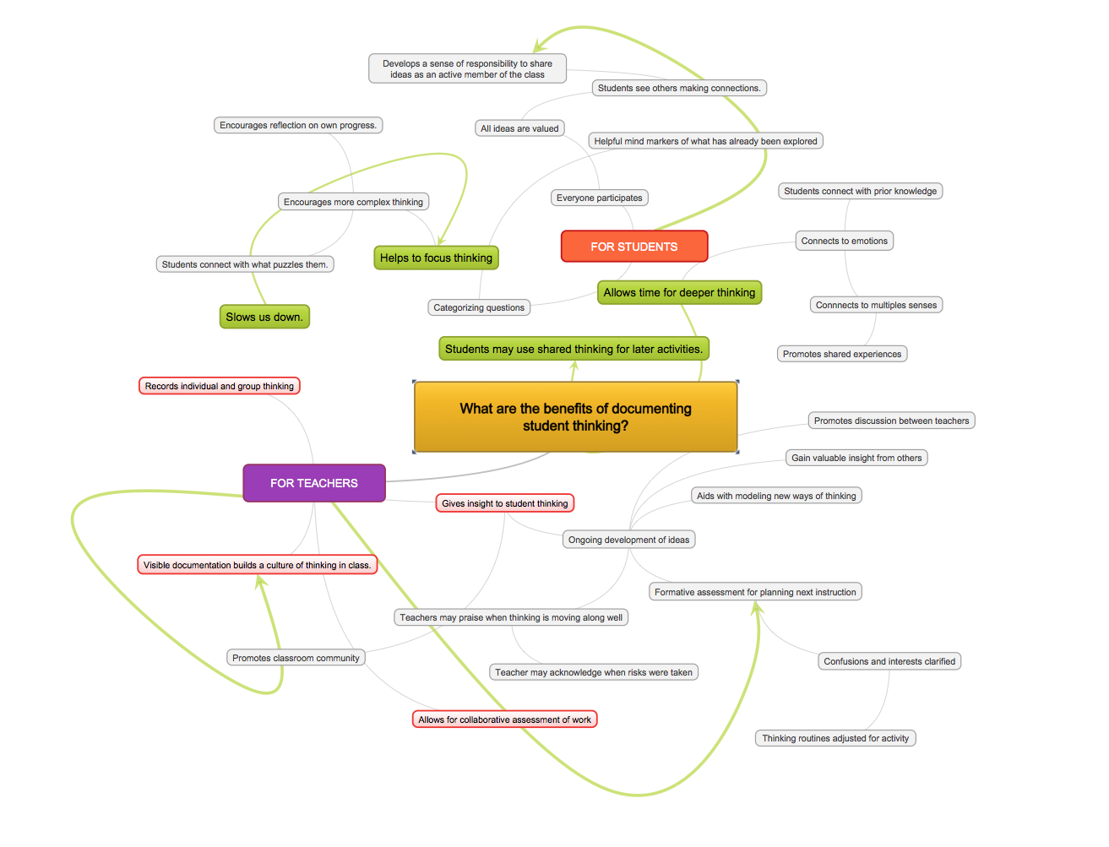
(“MindMaple” by Diana Stein, 2017)
Notes:
Part “A”
Making Thinking Visible
It's no secret that students learn best when they are actively and intentionally engaged in their own learning. Students achieve more focus when they can “see” their own thinking. Teachers intentionally work to develop students’ skills in self-regulated “Thinking Routines.” This involves setting their own goals, selecting effect strategies for reaching these goals, and monitoring and self-adjusting what they are actively engaged in depending on the demands of the task and their own strengths and needs (Moss & Brookhart, 2009, p. Chapter 4).
Resource reference for support while creating MindMaple (shown above):
Harvard Graduate School of Education. (2017). Artful thinking. Retrieved from http://pz.harvard.edu/projects/artful-thinking

Slide 12
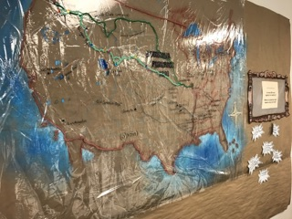
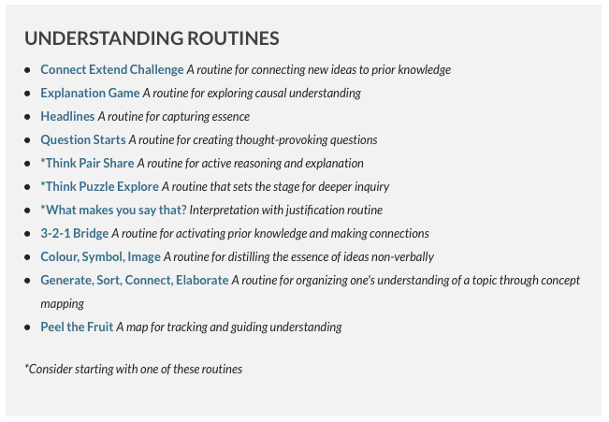
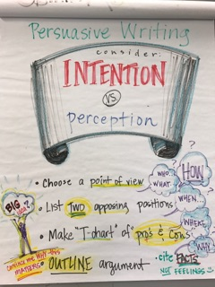
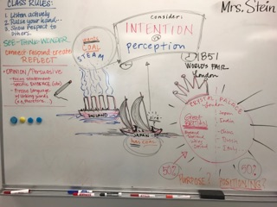
Making Thinking Visible continued
Mix it…
…Move it
Make it…

Slide 13
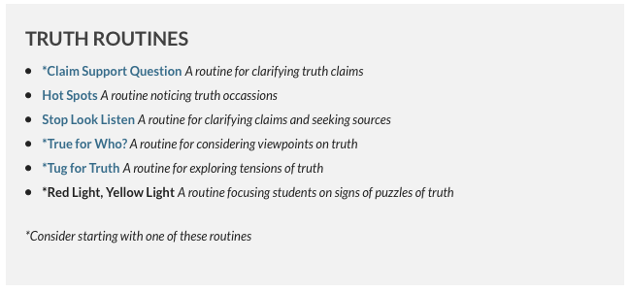
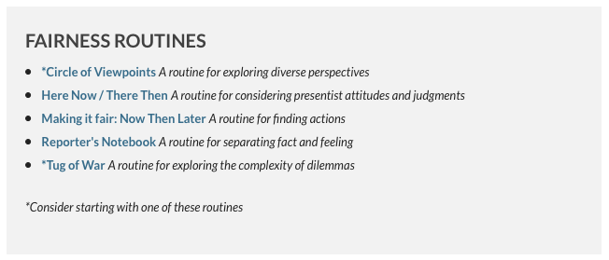
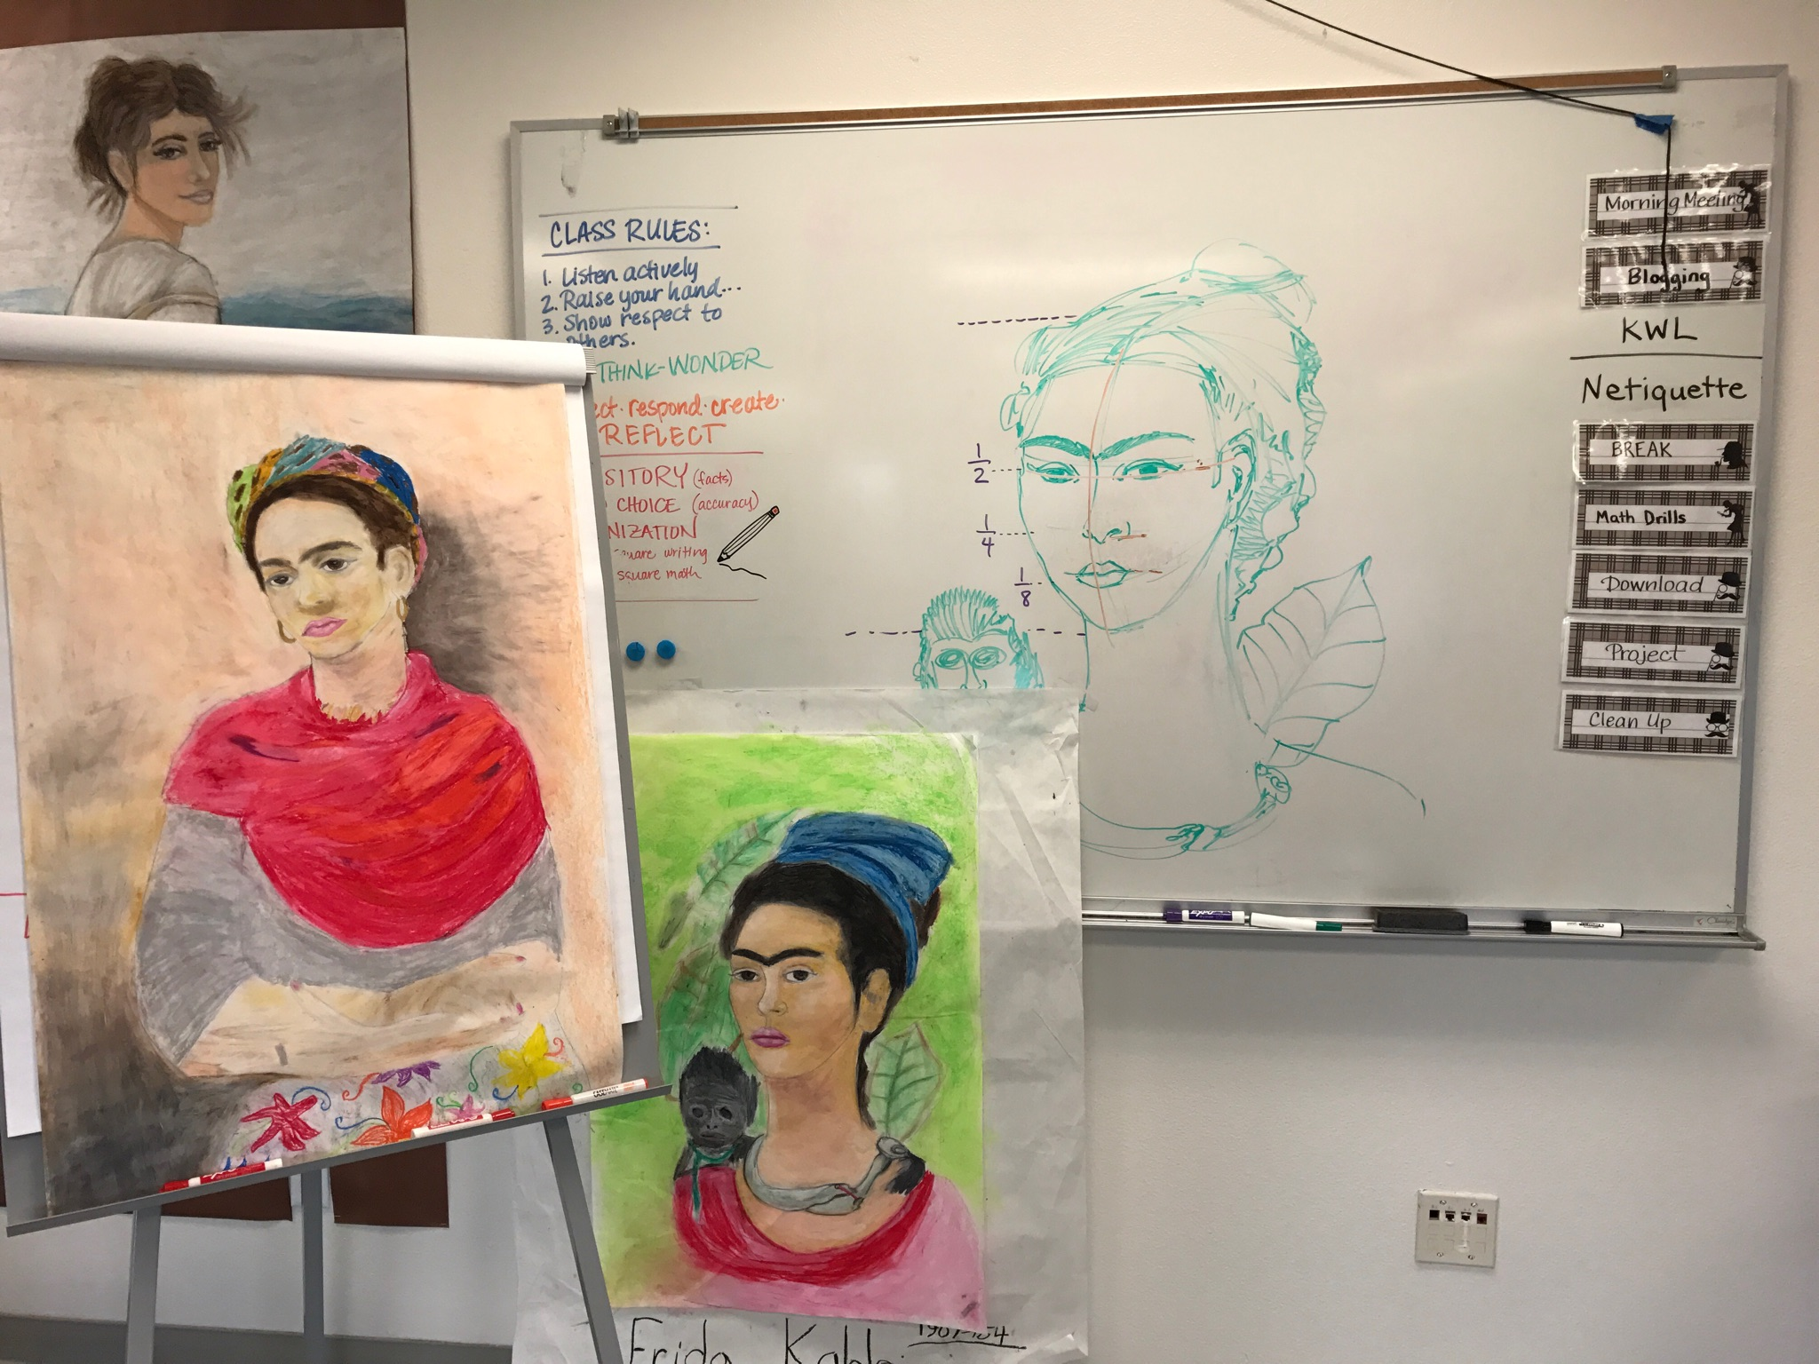
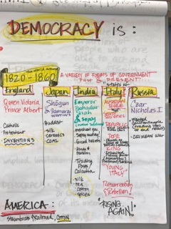
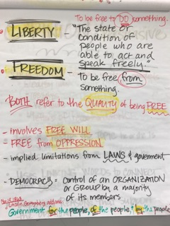
Making Thinking Visible
Notes:
According to Harvard Graduate School of Education, 2017: Thinking dispositions are developed through Thinking Routines, which are easy to learn and can deepen students’ thinking in the classroom. Here are four that we will explore today:
– A Routine for Exploring Works of Art and Other Interesting Things
– A Routine for Understanding
– A Routine for Fairness
– A Routine for Truth

Slide 14
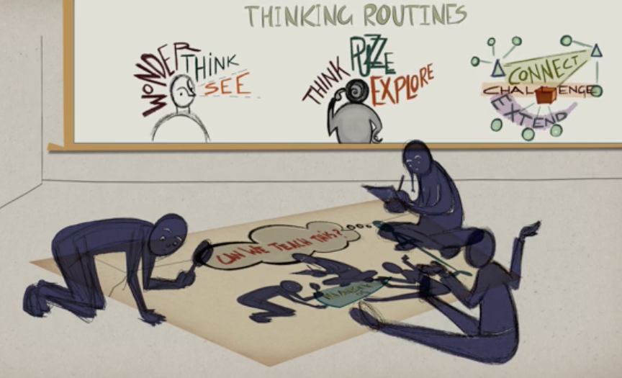
Artful Thinking
(Harvard Graduate School of Education, 2017)
Notes:
Part “B”
Artful Thinking:
Please cut and paste the link below to see a 4:36 minute video
https://player.vimeo.com/video/108000553?width=640&height=360&color=00adef&portrait=1&title=1&byline=1&autoplay=0&loop=0&player_id=vimeo-108000553

Slide 15
Artful Thinking
(Harvard Graduate School of Education, 2017)
Notes:
Art Making is Problem Solving. Creativity is about more than expression and aesthetics, but also about problem solving. While other disciplines encourage creative solutions to solving problems, the arts seek to find solutions beyond our understanding of the problem, pushing against what might be provable. Artists are inventors and test out new ideas. This is a quality made ideal for leadership.
One of the most rewarding things in teaching via art is that it gives students the ability and the confidence to do things that are new and out of the box. In the process of practicing the Arts students are encouraged to consider and commit to projects that might not see outcome until weeks, or sometimes months later. Students utilize strategies such as backward design, goal setting, and project-planning skills. This helps to develop character within our students, and a realization that they are committed to it for the long haul.
According to Harvard Graduate School of Education, 2017:
Focus on experiencing and appreciating art as a way to help students develop ways of thinking that support thoughtful learning. Artful Thinking helps teachers use works of visual art and music in ways that strengthen student thinking and learning in the arts and beyond. The goals of this program are to help teachers create connections between works of art and the curriculum, and to help teachers use art as a force for developing students’ thinking dispositions. Using the artist’s palette as a central metaphor, the Artful Thinking “palette” is comprised of six thinking dispositions that strengthen students’ intellectual behaviors. These dispositions are developed through Thinking Routines, which are easy to learn and can deepen students’ thinking in the classroom. (Harvard Graduate School of Education, 2017)
– A Routine for Exploring Works of Art and Other Interesting Things (*Please see Appendix B)

Slide 16
Making Thinking Visible
{
According to Harvard Graduate School of Education, 2017:
Visible Thinking is dedicated to helping students develop into better thinkers. To think well in day-to-day life, students must develop patterns of thinking in which their ability is combined with their inclination to think well and their awareness of thinking opportunities. Students must have not only the ability to think, but also the disposition to think.
In seeking to develop thinking dispositions, Visible Thinking takes an enculturative approach, meaning that we believe students’ dispositional development occurs best within a cultural context in which:
Thinking is valued
There is time for thinking
Rich opportunities for thinking abound
Thinking is regularly modeled
The process as well as the products of thinking are present in the environment (Harvard Graduate School of Education, 2017)
Notes:
According to Harvard Graduate School of Education, 2017:
Visible Thinking is dedicated to helping students develop into better thinkers. To think well in day-to-day life, students must develop patterns of thinking in which their ability is combined with their inclination to think well and their awareness of thinking opportunities. Students must have not only the ability to think, but also the disposition to think.
In seeking to develop thinking dispositions, Visible Thinking takes an enculturative approach, meaning that we believe students’ dispositional development occurs best within a cultural context in which:
Thinking is valued
There is time for thinking
Rich opportunities for thinking abound
Thinking is regularly modeled
The process as well as the products of thinking are present in the environment (Harvard Graduate School of Education, 2017)

Slide 17
Visible Thinking Routine
Notes:
SEE WONDER THINK booklet as pdf online and also as a printed handout https://issuu.com/captcurk/docs/mtv_routines
Reflection:
How does the See-Wonder-Think sequence help to build analysis skills?
Why is it helpful to do each step of this thinking routine in isolation?
How do students use the graphic organizer for other subject areas?

Slide 18
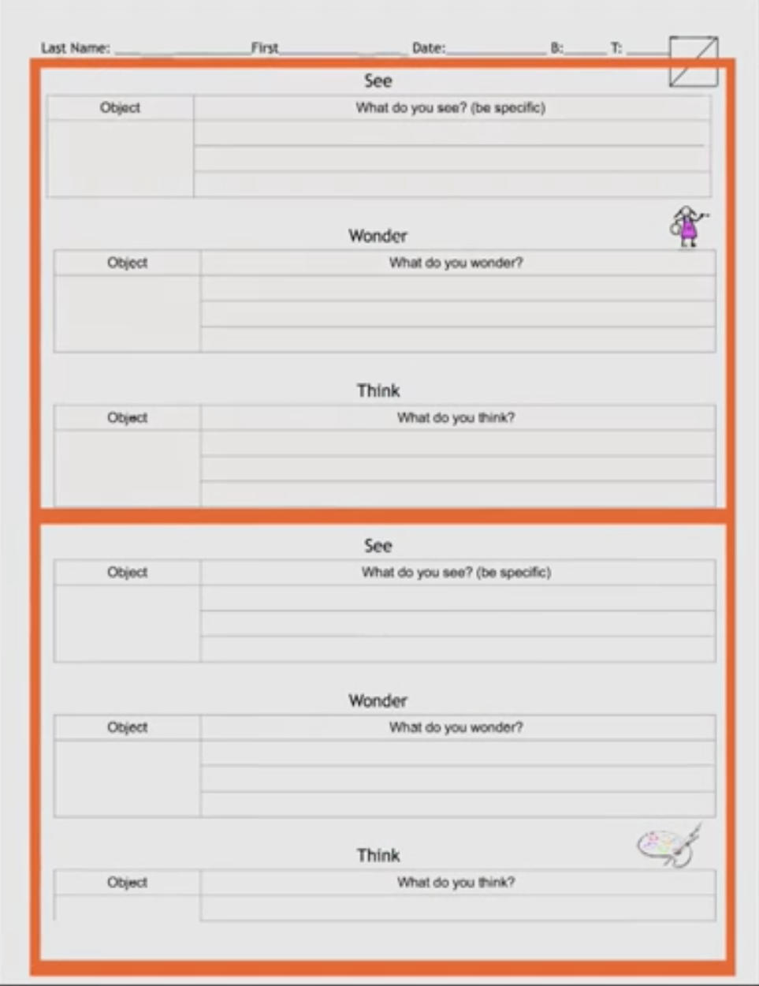
Notes:
See-Wonder-Think graphic organizer. Sample of one that could be preprinted and available for students to add to their InfoQuest Journals as they work independently, in pairs, and also in small groups.

Slide 19
See, Wonder, Think
STEP 1: What do I SEE? Look closely, create a thoughtful interpretation for 60 seconds. Identify small and big details. Write down three things that you saw on your graphic organizer.
STEP 2: What do I WONDER? Look at things that they can see, and wonder about things that they cannot see. (e.g., “I wonder if …. it’s still the same today?”, “I wonder who built that?”, “I wonder why…?)
STEP 3: What do I THINK? This is the last phase and it gives students the opportunity to make interpretations.
What can you infer from your observations?
At this point students look to questions from the “wonder” section and look for visual evidence to answer their own questions.
Sometimes they will be able to come up with a possible answer to their own question, and then other times they will not find what they need from visual evidence. At this point students may look to each other, or work independently, to investigate further.
Notes:
ACTIVITY: SEE-WONDER-THINK https://www.teachingchannel.org/videos/thinking-routine-getty
Each student will examine the image given to his or her team to See-Wonder-&-Think about.
*Please see the following slides for image choices that will be available as color prints. Names of the images will be covered with a Post-It note until later. STEP 1: What do I SEE? Look closely, create a thoughtful interpretation for 60 seconds. Identify small and big details. Write down three things that you saw on your graphic organizer.
STEP 2: What do I WONDER?
Look at things that they can see, and wonder about things that they cannot see.
(e.g., “I wonder if …. it’s still the same today?”, “I wonder who built that?”, “I wonder why…?)
STEP 3: What do I THINK?
This is the last phase and it gives students the opportunity to make interpretations.
What can you infer from your observations?
At this point students look to questions from the “wonder” section and look for visual evidence to answer their own questions.
Sometimes they will be able to come up with a possible answer to their own question, and then other times they will not find what they need from visual evidence. At this point students may look to each other, or work independently, to investigate further.

Slide 20
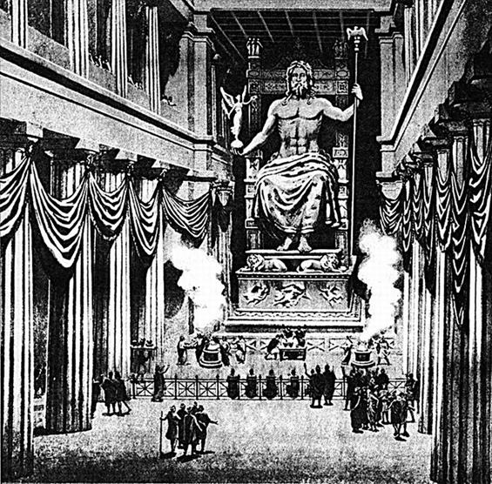
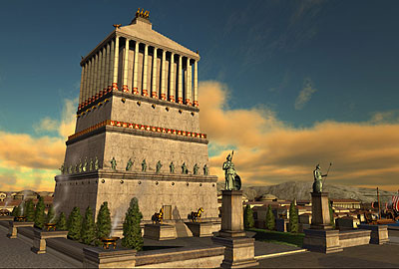
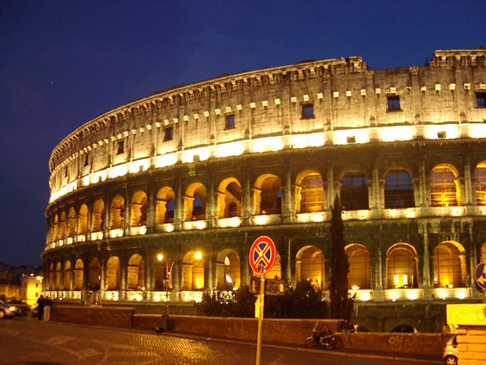
Explore Our Story
(Fabulous Traveling, 2017)
Notes:
Just for Fun
Print all Map Cards, cut them apart.
Place all of the Map Cards face down on a table.
Invited one person per team to come up to the table and blindly select a Map Card.
After all Map Cards have been selected, each person holding the map card must locate which team in the room has the image that relates to the map.

Slide 21
Explore Our Story
< Temple of Zeus –
Athens, Greece
Pyramids in Giza – Egypt
Temple of Artemis in Ephesus – Greek Empire, Modern Day Turkey
Hanging Gardens of Babylon, Mesopotamia >
Mausoleum at Halicarnassus – Persian Empire, Modern Day Turkey
Colossus of Rhodes – Greece
The Taj Mahal – India
Alexandria Lighthouse – Egypt
The Treasury – Petra, Jordan
Great Wall of China
Christ the Redeemer Statue –
Rio de Janeiro, Brazil
Chichen Itza, Mexico
Machu Picchu – Peru
The Coliseum – Rome, Italy
(Fabulous Traveling, 2017)
Notes:
Answer Key
This is a fun way to build teamwork and also collect clues to gather more information about the image on the card. This exercise could be extended to include a history lesson, geography lesson, government, writing lesson, geography, math (time, distance, speed, time zones/relationships, etc.), or an art lesson (music, food, visual, performing arts, etc.).
I hope that you had fun exploring our world together today. And remember, the next time you hear someone say, “There’s nothing to do!,” remind them what innovators, artists, and inventors do when they have time on their hands!
Thank you for attending and thank you for making every day special for our kids!
Images:
Fabulous Traveling. (2017). 7 wonders of the world– old vs. new. Retrieved from http://fabuloustraveling.com/7-wonders-of-the-world-old-vs-new/

Slide 22
3 PARTS : 1 extraordinary day!
PART II: Layered Learning Comes Alive
Analyze Integrated Lessons to understand layered curriculum to meet the needs of all students by including multiple modalities and Intelligences as aligned across subject matter, California State Standards, and Common Core State Standards. *Please note: Standards will be listed as links on final documentation for Signature assignment. Please see Appendix C after references.
Notes:
Integrated Curriculum
What exactly is integrated curriculum? In its simplest conception, it is about making connections– connections to real life, across disciplines… skill-based and knowledge-based (Drake & Burns, 2017).
Interdisciplinary approaches vary including a fusion of skills, knowledge, and even attitudes into the approved Common Core and State Standards. Learning centers are often put into practice within classrooms at all grade levels. These may include multiple disciplines united in theme, and offer students various ways to examine a concept or topic. In higher grades students generally have subject area experts who facilitate inquiry-based learning. Through Integrated Curriculum students often experience multiple subjects (e.g., Literature, History, Science, and Art) working within a theme-based unit of study. Multi-age groups working in parallel become interconnected through performance tasks and hands-on learning experiences. Teachers who facilitate these types of learning activities often observe multiple benefits, including:
Students have choices in how they will learn the content.
Students exhibit excellent on-task behavior.
Students work collaboratively.
Multi-age teams formed within the multi-age classes
Students are engrossed both as presenters and as the audience for the half-day performance based learning labs
Students use a wide range of presentation products, such as video, debate, sculpture, and so on.
Students demonstrate depth of understanding of topics as a result of their sustained interest around various questions (e.g., Essential Questions: Is it ever okay to act against civil authority? What circumstances might require unity at all cost?).
Fewer recess problems occurred during this two-week period (Drake & Burns, 2017).
Teachers feel deeply satisfied with the unity, process, and the results.

Slide 23
Interdisciplinary Magic
Multi-age groups working in parallel become interconnected through performance tasks and hands-on learning experiences.
Notes:
Launch this link to see a 5:05 minute animation explaining Layered Curriculum:
https://www.youtube.com/watch?v=gC1fQN-YD_c&t=21s

Slide 24
Choices.
Integrated Curriculum
English L.A.
Science
Drama
Geography
Physical Education
Math
Design & Technology
History
Music
Visual Art
Dance
Notes:
Integrated Curriculum
What exactly is integrated curriculum? In its simplest conception, it is about making connections– connections to real life, across disciplines…
skill-based and knowledge-based (Drake & Burns, 2017).
Interdisciplinary approaches vary including a fusion of skills, knowledge, and even attitudes into the approved Common Core and State Standards. Learning centers are often put into practice within classrooms at all grade levels. These may include multiple disciplines united in theme, and offer students various ways to examine a concept or topic. In higher grades students generally have subject area experts who facilitate inquiry-based learning. Through Integrated Curriculum students often experience multiple subjects (e.g., Literature, History, Science, and Art) working within a theme-based unit of study.

Slide 25
Interdisciplinary Magic
Students have choices in how they will learn the content.
Students exhibit excellent on-task behavior.
Students work collaboratively.
Multi-age teams formed within the multi-age classes
Students are engrossed both as presenters and as the audience for the half-day performance based learning labs
Students use a wide range of presentation products, such as video, debate, sculpture, and so on.
Students demonstrate depth of understanding of topics as a result of their sustained interest around various questions (e.g., Essential Questions: Is it ever okay to act against civil authority? What circumstances might require unity at all cost?).
Fewer recess problems occurred during this two-week period (Drake & Burns, 2017).
Teachers feel deeply satisfied with the unity, process, and the results.
Notes:
Integrated Curriculum (continued)
Multi-age groups working in parallel become interconnected through performance tasks and hands-on learning experiences. Teachers who facilitate these types of learning activities often observe multiple benefits, including:
Students have choices in how they will learn the content
Students exhibit excellent on-task behavior.
Students work collaboratively.
Multi-age teams formed within the multi-age classes
Students are engrossed both as presenters and as the audience for the half-day performance based learning labs
Students use a wide range of presentation products, such as video, debate, sculpture, and so on.
Students demonstrate depth of understanding of topics as a result of their sustained interest around various questions (e.g., Essential Questions: Is it ever okay to act against civil authority? What circumstances might require unity at all cost?).
Fewer recess problems occurred during this two-week period
Teachers feel deeply satisfied with the unity, process, and the results. (Drake & Burns, 2017)

Slide 26
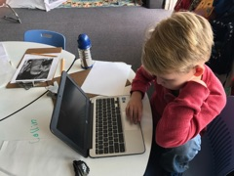
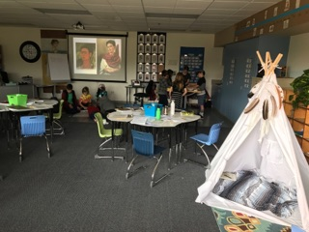
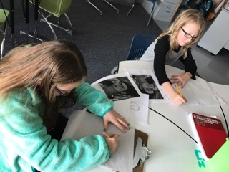
Project-Based Learning
{
Notes:
Project-Based Learning
Project-based learning engages all students by requiring them to tackle a specific Essential Question, or problem. Steps to selecting topics for project-based learning may spring forward from the State Standards, and/or the CCSS’s, and blend with student’s individual interests and local resources. The teacher becomes the facilitator, guiding students to generate questions and explore deeper on what they already know about a given subject or topic. The teacher also provides resources (e.g., Internet driven, text or real world InfoQuests) for the students with opportunities to solve the Essential Question in a variety of ways including but not limited to writing, history, math, science, and the arts.
InfoQuests are ongoing journal responses (e.g., online as blogs, Google docs, slide shows, websites, on paper, etc.) as personal quests for deeper understanding to the Essential Question. Discovery includes Close Reading, text citation, real world exploration, simulations, model making, creating art, and real-world explorations.

Slide 27
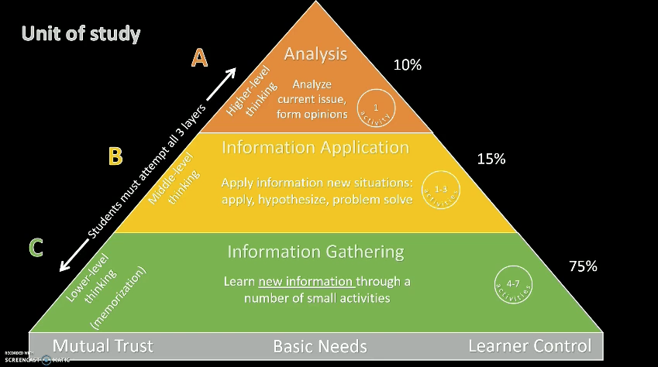
Layered Learning Comes Alive!
(Evans, 2016)
Notes:
Kathy Nunley’s model of Layered Curriculum illustrates how Bloom’s Taxonomy transcends through various levels of depth and complexity related to the subject of interest. Learning is student-driven and student-focused, resulting in higher engagement and critical thinking.
*For more details please cut and past this link into your browser and click through to see more:
https://www.youtube.com/watch?v=V8n0qkdbpAo
Understand the balance between dependence and interdependence while facilitating CCSS integrated lessons with technology as integral components of Layered Curriculum. Educators are free to take on the role of facilitators and organizers of learning activities; they are free to focus on small groups and individuals who need more specialized attention; and they can coach their students in how to process information, helping them to make choices and validate their learning. (Van Dusen & Sailor, 1995)
Please follow the links below when planning and integrating lessons for your students:
The Common Core State Standards for English Language Arts & Literacy in History/Social Studies, Science, and Technical Subjects (“the standards”) represent the next generation of K–12 standards designed to prepare all students for success in college, career, and life by the time they graduate from high school.
English Language Arts Standards | Common Core State Standards ...
www.corestandards.org/ELA-Literacy/
Mathematics Standards | Common Core State Standards Initiative
www.corestandards.org/Math/
Mathematics Standards. Download the standards Print this page. For more than a decade, research studies of mathematics education in high-performing ...
‎Algebra · ‎Operations & Algebraic Thinking · ‎Counting & Cardinality · ‎Introduction
Content Standards (K-12)
Standards adopted by the California State Board of Education for English-language arts, mathematics, history-social science, science, and visual and performing arts.
Curriculum Frameworks & Instructional Materials
Curriculum guidelines for K-12 subjects, and State Board adopted K-8 instructional materials.
Common Core State Standards
Information and frequently asked questions about the new academic content standards adopted by the State Board of Education on August 2, 2010.
Instructional Quality Commission
The Instructional Quality Commission is an advisory body to the California State Board of Education on matters related to curriculum, instructional materials, and content standards.
Layered Learning Comes Alive (60 minutes) (Appendix C) ACTIVITY: SEE–THINK–WONDER–KNOW?

Slide 28
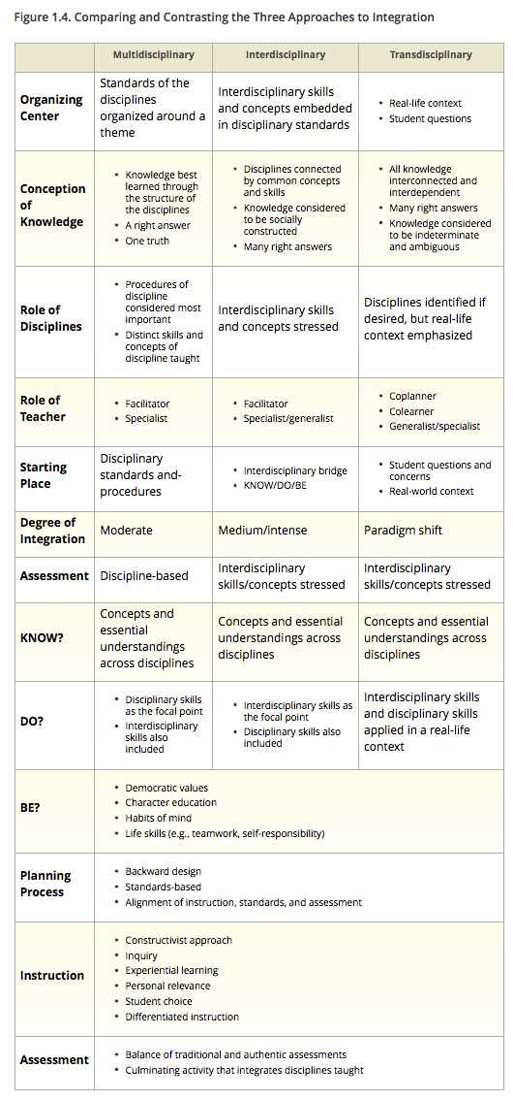
3 Ways : 1 Concept
(Drake & Burns, 2004)
Notes:
Comparing and Contrasting Three Approaches to Integration

Slide 29
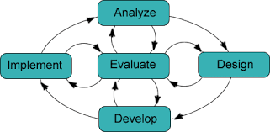
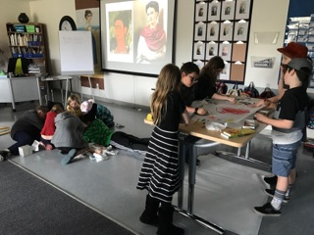
The ADDIE Model
Analyze
Design
Develop
Implement
Evaluate
Notes:
The ADDIE Model: A framework for instructional and academic excellence
Our Learning Management System (LMS) where all of our interactive content is housed is Schoology®. Students follow their Assignment Work Calendar online via their courses on Schoology®. All of the work is privately secured as they each have a unique user name and log on password. Parent partners also have their own access codes to their child’s work so that they may successfully faciliate instruction while their child is at home.
Students look to their Assignment Calendar read the assigned text, both online and in supplied textbooks, on the days that they are not at workshop. InfoQuests are journals that are ways to log ongoing investigations to the Essential Question. (More on this topic will be addressed in the next slide). Workshop days on campus are interactive, inter-subject, inter-grade, and multiple modality labs. Students arrive to the workshop prepared to engage in rich dialog, projects, and hands-on activities that arc from the assigned reading for world and U.S. History.
Language Arts and Literature requirement are separated by grade level online, as per the California State Standards and Common Core State Standards mandate. Additional literature is assigned to the whole group (mixed grades 3rd, 4th, and 5th) in the form of historical fiction that is in alignment with each particular Unit of Study.
Writing is taught on workshop days and is woven into the daily activities that are at completed at home and also during workshops together. Teachers use Excellence in Writing, Six Traits Plus One, and Stoplight Writing as methodologies. Each teacher builds in the use of technology into most assignments in some way or another, including writing blogs, creating presentations using Google docs, Slide Share, Power Point, Keynote, animations PowToons), Thing Link, Glogster, and more. The students are immersed within technology and utilize it intuitively as a mode of lesson delivery and well as a means to present with.
Mathematics is completed online via Khan Academy. Missions are assigned based on grade level and/or MAP (Measures in Academic Progress testing via NWEA). Teachers are Coaches online with Khan Academy as they are listed by the parent of the student(s). This permits the teacher to hover over progress and receive daily or weekly progress reports computed in real time trough data management systems and analysis proprietary to Khan Academy.

Slide 30
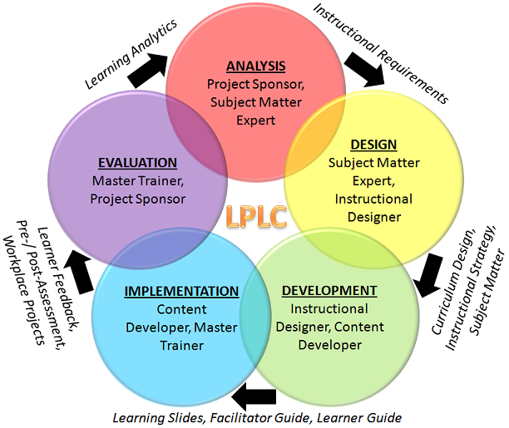
Meet
ADDIE
Notes:
The ADDIE Model Explained
Analysis: Our teachers build curriculum based on California State Standards as aligned with Common Core State Standards.
Design: We address the learning needs of the grade levels being taught, as well as build in supports, modifications, and enrichment/extensions to ensure that all levels are built into the programming from the start.
Development: As we meet our students needs day to day modifications are made to meet them where they are. This includes making changes in the moment, as well as having identified modifications in mind as a result of prior and ongoing academic analysis as we partner with parents.
Implementation: (Technology Integration via Schoology) Our teaching team develops customized content and shares it on the LMS (Schoology). This provides our students with information that is timely, based on meeting the individual learners’ needs. Schoology is also our communication platform for class discussion boards and posting, submitting, and scoring of assignments.
Evaluation: Students are evaluated formatively in all of their actions, both online as well as in person working independently and cooperatively with their peers. As students build their academic strengths they are simultaneously building their Emotional Intelligence skills. Additionally, students are expected to formally present their cumulative body of work as one major project or Task Assessment per Unit of Study (approximately once every six weeks, six time per school year).

Slide 31
Enjoy your lunch.
(“Spice of Life Catering”, 2013)

Slide 32
3 PARTS : 1 extraordinary day!
PART III: Four Keys to Coaching Conversations with Confidence Improve observational feedback and communication to improve school performance during coach-teacher conversations by using four types of conversations: Reflective, Facilitating, Coaching, and Directing. (Marzano, 2017)
Notes:
Four Keys to Coaching Conversations with Confidence (60 minutes) (Appendix D)

Slide 33
Four Keys to Coaching Conversations with Confidence
(ABC News, 2010)
Notes:
Discussion points:
What would success look like, sound like, and feel like?
How would you know if your students were successful?
What makes a great teacher? Watch: https://www.youtube.com/watch?v=7bIQ4-3XSxU
Reference and Image:
Sule, J. (2010). ABCNews - What makes great teachers. Retrieved from http://ABCNews - What Makes Great Teachers - 02-26-2010.ASF

Slide 34
The need is urgent; teachers work at the frontier of everything education is meant to do. Public education itself grapples intimately with big changes in America, from new languages to health epidemics to economic imperatives. Our answer to the challenge of improving teachers' training will influence the experience children have in classrooms -- and the skills with which children enter adult life -- for years to come. It's a question of what kind of future we want to create. (Rubenstein, 2017)
Four Keys to Coaching Conversations with Confidence
Notes:
The need is urgent; teachers work at the frontier of everything education is meant to do. Public education itself grapples intimately with big changes in America, from new languages to health epidemics to economic imperatives. Our answer to the challenge of improving teachers' training will influence the experience children have in classrooms -- and the skills with which children enter adult life -- for years to come. It's a question of what kind of future we want to create. (Rubenstein, 2017)
Teacher preparation programs, and ongoing professional development, must be responsive to the increasingly complex needs of our students. "Just in time training" is sometimes too late, as it doesn't build in time for practice, analysis, reflection, and revision. Conversely, teacher trainings that seem as though they don't apply to the given set of immediate needs can easily seem like a waste of valuable time and resources. As we consider the ways in which we are building teacher's capacities, we must be cognitive of the critical roles that coaching and guiding will play on more personalized and meaningful ways on a daily basis.
Whole group instruction seems to be the way that most staff development trainings are designed. Yes, we do breakout into small groups and come back a little while later to share out with the larger group, but the best professional development comes from collaborating with each other within ongoing, experiential needs on any given day. It is connected and derived from working with our students, analyzing what their needs are, and then responding to these needs in a timely manner. With so many issues facing teachers today, it is critical that we all have ongoing and regular opportunities to learn from each other if we are to create the kind of future that includes high-quality teaching that is vital for student success. (Edutopia, 2017)
While most of us would agree that coaching is vital and necessary, most schools don't have the resources to appoint instructional coaches to work with the teaching staff. The principal's day is often consumed with administrative duties that take him or her away from the classrooms. So, it will require creativity in staffing and planning to build in time to coach each other in order to grow and support great teachers.
Source:
Edutopia. (2017). An Introduction to Teacher Development. Retrieved from http://edutopia.org

Slide 35
How can you encourage your teachers to become learners again?
What type of support did you notice in this video that you would like to implement into your school site?
How can you, as the principal or teacher leader, continue to grow and learn in your position?
Four Keys to Coaching Conversations with Confidence
Notes:
Improve observational feedback and communication to improve school performance during coach-teacher conversations by using four types of conversations: Reflective, Facilitating, Coaching, and Directing. (Marzano, 2017)
Discussion points for small groups: (with possible responses)
How can you encourage your teachers to become learners again?
Creating a sense of wonder promotes action. As teachers we need to be mindful to build in time for curiosity to develop. This requires us to stay informed and get exposed to new experiences ourselves, this in return will build momentum of curiosity within our students.
What type of support did you notice in this video that you would like to implement into your school site?
The support evidenced within the video showed that an Instructional Coach, who was hired specifically to visit with each teacher at least once per month, was available to guide and facilitate teacher growth. This was done through inspired ways utilizing images, words, and phrases to connect the content in meaningful ways. This requires the learner to invent a mind map using imagery along with the Scientific Process to dig deeper to find their own connections to the content.
How can you, as the principal or teacher leader, continue to grow and learn in your position?
Tightly woven learning communities share information freely and generously, without fear of judgment or competition. This includes sharing ideas for integrating technology fully. Designing meaningful ways to implement technology as teachers, and also as students, require the teacher to assume the role of continual learner. As principal it is important to make certain that technology tools are supported with time for hands-on training. This may include video tutorials, but at best would also be supported with a Tech Support person who is there to guide as needed.

Slide 36
Reflective conversations are designed to help teacher recognize the beliefs and behaviors that affect their classroom’s practice.
Facilitating conversations are designed to help teachers set goals.
Coaching conversations are designed to move teachers closer to accomplishing their goals.
Directing conversations are designed to prompt a teacher to action. (Marzano, 2017)
Four Keys to Coaching Conversations with Confidence
Notes:
Four Keys to Coaching Conversations with Confidence Improve observational feedback and communication to improve school performance during coach-teacher conversations by using four types of conversations: Reflective, Facilitating, Coaching, and Directing (Marzano, 2017).
According to Marzano (2017)
Coaches can help teachers facilitate discussions to improve school performance during coach-teacher conversations by using one of the four types of conversations:
Reflective conversations are designed to help teachers recognize the beliefs and behaviors that affect their classroom practice.
Facilitating conversations are designed to help teachers set goals.
Coaching conversations are designed to move teachers closer to accomplishing their goals.
Directing conversations are designed to prompt a teacher to action.
(*Please see Appendix D for Activity that aligns with this break out session.)
Multi-age groups working in parallel become interconnected through performance tasks and hands-on learning experiences. This is done through thoughtful planning, design, delivery, assessment, and reflection. Projects designed in unison, with shared passion and collective expertise are destined to move learning results further, faster.
Teacher leaders, as a direct result of today’s training it is my great hope that you will come back to you campuses trained and ready to implement the new strategies, excited to train others on what you have learned, and are empowered to move forward as you demonstrate these techniques and strategies with your colleagues based on positive todays’ learning results. When we all share what we learn, we establish good practices for all! Passion and purpose go a long way when we’re all united by our shared vision. I hope that you had fun exploring our world together today. And remember, the next time you hear someone say, “There’s nothing to do!,” remind them what innovators, artists, and inventors do when they have time on their hands!

Slide 37
Interdisciplinary Magic
{
R E – C A P : O B J E C T I V E S
Develop routines and skills in and Visible Learning and Artful Thinking to promote self-directed, cooperative, and collaborative students (Focus: Critical Thinking & Behavior)
Understand how to analyze integrated lesson essentials/Layered Learning including design, delivery, assessment, and reflection components to meet the needs of all students by including multiple modalities and Intelligences as aligned to California State Standards and Common Core State Standards (Focus: Curriculum Design, Integration, & Assessment)
Utilize reflection to self-evaluate with clear and measureable in mind (Focus: Coaching, Confidence, & Self-Analysis)
Multi-age groups working in parallel become interconnected through performance tasks and hands-on learning experiences.
Notes:
(Re-Cap) Three learning goals for today:
Develop routines and skills in Artful Thinking and Visible Learning including:
Reasoning
Questioning and Investigating
Exploring Viewpoints
Observing and Describing
Finding Complexity
Comparing and Connecting
(Harvard Graduate School of Education, 2017)
Understand the balance between dependence and interdependence while facilitating CCSS integrated lessons with technology as integral components of Layered Curriculum. Educators are free to take on the role of facilitators and organizers of learning activities; they are free to focus on small groups and individuals who need more specialized attention; and they can coach their students in how to process information, helping them to make choices and validate their learning. (Van Dusen & Sailor, 1995)
Utilize reflection to self-evaluate with clear and measureable goals in mind.
“Learning intentions without success criterion are hopeless” (Hattie, 2015). What makes a great teacher? https://www.youtube.com/watch?v=7bIQ4-3XSxU
What would success look like, sound like, and feel like?
How would you know if your students were successful? As a result of professional development faculty will be engaged in ongoing reflection, self-assessment, and self-directed change and improvement with strategies for building capacity through systems of support and development, together. At the end of the day, and all of the assessments, it is our passion and our collective expertise that impacts learning results the most. (CAPE 5)
Instructional Leadership OBJECTIVES:
Understand how to analyze integrated lesson essentials including design, delivery, assessment, and reflection components to meet the needs of all students by including multiple modalities and Intelligences as aligned to California State Standards and Common Core State Standards
Develop routines and skills in Visible Learning and Artful including: Reasoning, Questioning and Investigating, Exploring Viewpoints, Observing and Describing, Finding Complexity, Comparing and Connecting
Utilize reflection to self-evaluate with clear, measurable goals in mind. What would success look like, sound like, and feel like? How would you know (measure) if your students were successful?

Slide 38
Go make some
Creating a philosophy of love of learning with grace, humility, and also with a sense of humor as needed is one that includes all voices.
Thank you for making a difference in your students’ lives, every day.
Magic
Notes:
Conclusion
Today’s activities were designed to build teamwork and also collect clues to gather more information about promoting implementation of K-12 Standards, while evaluating, analyzing, and providing feedback on our instructional practices to promote student learning and teacher professional growth. Within the breakout sessions today you have demonstrated an understanding of The Classical Academies’ within the community context, including cultural, socioeconomic, and political factors. Communication of our school-wide learning outcomes is clear and visible in all of our actions as we strive for excellence in education, together.
The exercises shared today could be extended to include a history lesson, geography lesson, government, writing lesson, geography, math (time, distance, speed, time zones/relationships, etc.), or an art lesson (music, food, visual, performing arts, etc.). As educators, when we reflect on what worked (and also what didn't work as well as expected) we find ourselves in the position of making choices that will invite the learner to take on more ownership and risk taking. It's also important to consider the parental role in this mindset, as we Partner with Parents in the education of their children.
As parents we each play a pivotal and critical role. We present challenges as opportunities. We reinforce the value of commitment, as we model grit and Growth Mindset over time. Improvement over time takes commitment. Growing a culture of continuous improvement over time takes time to germinate– amongst staff, and also amongst students and their families. Creating a philosophy of love of learning with grace, humility, and also with a sense of humor as needed is one that includes all voices.
I hope that you found exploring the three learning goals of the day to be beneficial, with some practical and helpful tools that you may use in your classrooms straight away. Visible Learning, Artful Thinking, Layered Curriculum, and coaching the difference between dependence and interdependence while facilitating CCSS integrated lessons to guide meaningful learning experiences one student at a time. Thank you for making a difference in your students’ lives every day. Go make some magic!

Slide 39
References
Drake, S. M., & Burns, R. C. (2004). Meeting standards through integrated curriculum. Alexandria, Virginia: ASCD. Edutopia. (2017). An Introduction to Teacher Development. Retrieved from http://edutopia.org
Fabulous Traveling. (2017). 7 wonders of the world– old vs. new. Retrieved from http://fabuloustraveling.com/7-wonders-of-the-world-old-vs-new/
Hattie, J. (2013). Why are so many of our teachers and schools so successful? John Hattie at TEDxNorrkoping. Retrieved from https://www.youtube.com/watch?v=rzwJXUieD0U
Harvard Graduate School of Education. (2017). Artful thinking. Retrieved from http://pz.harvard.edu/projects/artful-thinking
Hayes Jacobs, H. (1989). Interdisciplinary curriculum. Retrieved from http://www.ascd.org/publications/books/61189156/chapters/Integrating-Thinking-and-Learning-Skills-Across-the-Curriculum.aspx
Loehr, L. (2015). John Hattie learning intentions and success criteria. Retrieved from https://www.youtube.com/watch?v=OGyvDvOegXE
Marzano Research. (2017). Tips from Dr. Marzano coaching classroom instruction. Retrieved from https://www.marzanoresearch.com/resources/tips/cci_tips_archive
Moss, C. M., & Brookhart, S. M. (2009). Advancing Formative Assessment in Every Classroom . Alexandria, Virginia: ASCD.
Partnership for 21st Century Learning. (2017). From the ‘3 Rs’ to the ‘4 Cs’. Retrieved from http://www.p21.org
Sharratt, L., & Fullan, M. (2012) Putting FACES on the data: What great leaders do! Thousand Oaks, CA: Corwin/SAGE.
Spice of Life Catering. (2013). Retrieved from http://spice-of-life-catering.com/event_menus/heavy_hors_doeuvres
Sule, J. (2010). ABCNews - What makes great teachers - 02-26-2010.ASF. Retrieved from https://www.youtube.com/watch?v=7bIQ4-3XSxU
TED Talks. (2013). Every kid needs a champion | Rita Pierson. Retrieved from https://www.youtube.com/watch?v=SFnMTHhKdkw
Van Dusen, L., & Worthen, B. (1995, October). Can integrated instructional technology
transform the classroom? Educational Leadership, 53(2), 28 - 33.
Retrieved from http://www.ascd.org/publications/educational
leadership/oct95/vol53/num02/Can-Integrated-Instructional-Technology
Transform-the-Classroom¢.aspx
VisibleThinking...ThinkingRoutines/.../SeeThinkWonder/.see think wonder pdf.
Retrieved from http://pz.harvard.edu/resources/see-think-wonder
Wamsley, M. (2014, August 6). VideoScribe on John Hattie's visible learning [Video file]. Retrieved from You Tube website: https://www.youtube.com/watch?v=5WSTcVDwH3s
Wiles, J. W., & Bondi, J. C. (2015) Curriculum development: A guide to practice (9th ed.). Upper Saddle River, NJ: Pearson.

Slide 40
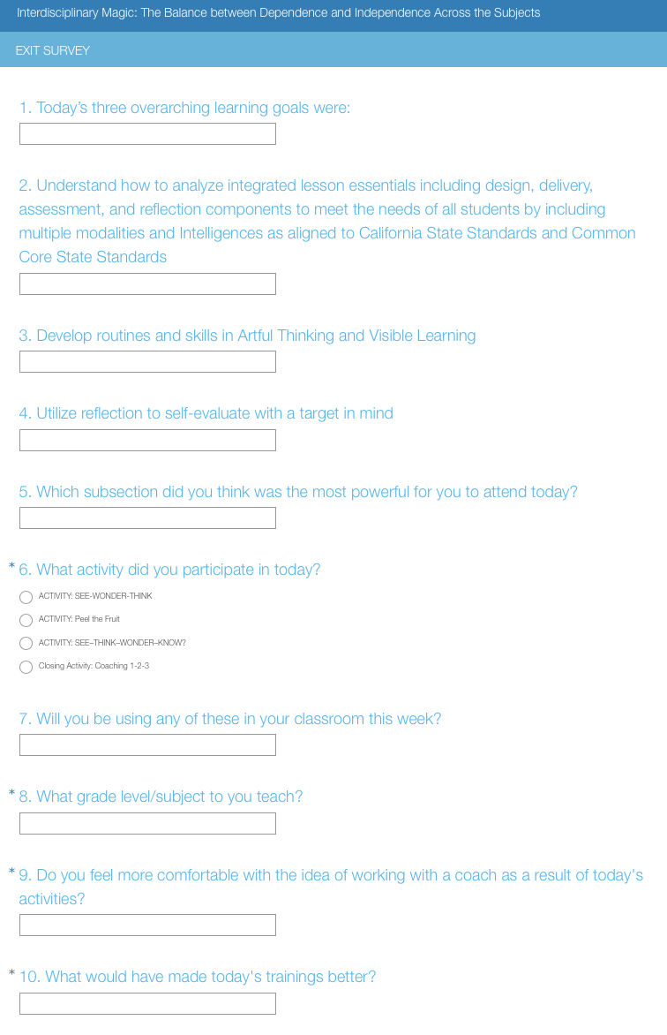
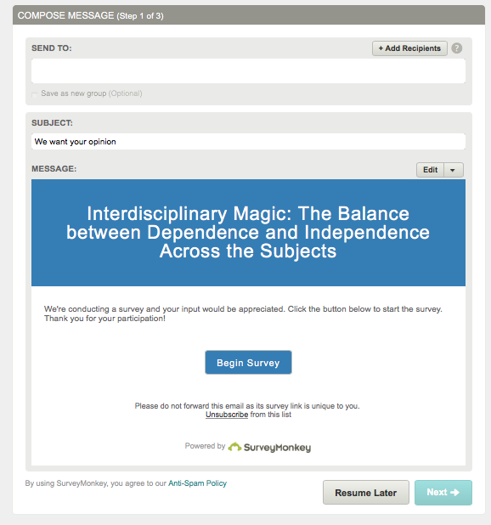
Exit Survey
Notes:
https://www.surveymonkey.com/home/?ut_source=header
You were just emailed the link to the survey shown above. Please log on and respond to the questions listed so that we may continue to deliver excellence in Professional Development Learning Days in the furture. The first twenty responders will receive a redeemable Starbucks gift card.
Thank you again for an incredible day of growing and learning, together.

Slide 41
A C T I V I T I E S
{
Five activities that encourage reflective practice for each participating teacher:
BREAKOUT SESSIONS
Visible Learning, in Caiman Hall (1:15 minutes) (Appendix A) ACTIVITY: Peel the Fruit
Artful Thinking, in the VAPA Room (1:15 minutes) (Appendix B) ACTIVITY: See-Think-Wonder
Layered Learning Comes Alive (60 minutes) (Appendix C) ACTIVITY: SEE–THINK–WONDER–KNOW?
Four Keys to Coaching Conversations with Confidence (60 minutes) (Appendix D)
Coaching 1-2-3 Closing Activity
appendix

Slide 42
A C T I V I T I E S
{
Five activities that encourage reflective practice for each participating teacher:
BREAKOUT SESSIONS
Visible Learning, in Caiman Hall (1:15 minutes) (Appendix A) ACTIVITY: Peel the Fruit
Artful Thinking, in the VAPA Room (1:15 minutes) (Appendix B) ACTIVITY: See-Think-Wonder
Layered Learning Comes Alive (60 minutes) (Appendix C) ACTIVITY: SEE–THINK–WONDER–KNOW?
Four Keys to Coaching Conversations with Confidence (60 minutes) (Appendix D)
Coaching 1-2-3 Closing Activity
appendix
Notes:
APPENDIX A: Visible Learning
https://www.youtube.com/watch?v=5WSTcVDwH3s
*Please follow this link to see a 3:51 minute Video Scribe animation by Michael Wamsley See: http://www.visiblethinkingpz.org/VisibleThinking_html_files/05_SchoolWideCultureOfThinking/05b_Introduction.html
According to Harvard Graduate School of Education, 2017:
Visible Thinking is dedicated to helping students develop into better thinkers. To think well in day-to-day life, students must develop patterns of thinking in which their ability is combined with their inclination to think well and their awareness of thinking opportunities. Students must have not only the ability to think, but also the disposition to think.
In seeking to develop thinking dispositions, Visible Thinking takes an enculturative approach, meaning that we believe students’ dispositional development occurs best within a cultural context in which:
Thinking is valued
There is time for thinking
Rich opportunities for thinking abound
Thinking is regularly modeled
The process as well as the products of thinking are present in the environment
Teachers at The Classical Academies integrate formative assessment in a wide variety of ways. Since formative assessment is ongoing, it is important to consider using a variety of tools to keep the learning engaging, and the students focused. Students as producers may choose to produce blogs, Infographics, ThingLinks, and any other digital format that will help them to investigate and solve problems. These tools allow students to “show what they know”. Visible learning is exactly that. Visible learning involves abilities, attitudes, and alertness, all three at once (Harvard Graduate School of Education, 2017).
In order for students to remain invested in their own learning they need to be the ones in the driver's seat. Since technology keeps evolving, we all need to keep learning and discovering more and more ways to make learning come to life. Organizing teaching resources and activities on one's own website and integrating technology bring students learning experience to a different level. Sharing links and offering digital discussions as opposed to a constant paper flow allows students to access and share class resources in a more organized fashion (Palmer, 2015).

Slide 43
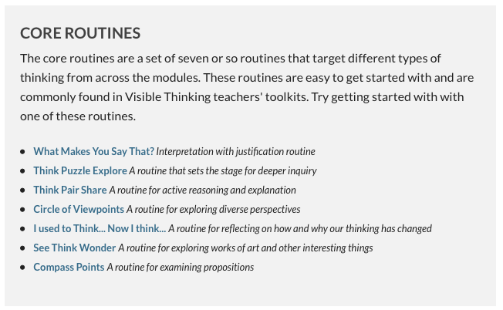
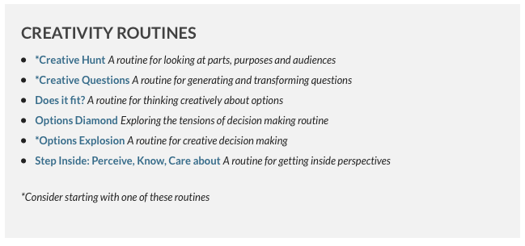
(Harvard Graduate School of Education, 2017)
Notes:
Visible Thinking is the product of a number of years of research concerning children’s thinking and learning, along with a sustained research and development process in classrooms.
One important finding was that skills and abilities are not enough. They are important of course, but alertness to situations that call for thinking and positive attitudes toward thinking and learning are tremendously important as well. Often, we found, children (and adults) think in shallow ways not for lack of ability to think more deeply but because they simply do not notice the opportunity or do not care. To put it all together, we say that really good thinking involves abilities, attitudes, and alertness, all three at once. (KEY POINT) Technically this is called a dispositional view of thinking. Visible Thinking is designed to foster all three.
Another important result of this research concerns the practical functionality of the Visible Thinking approach -- the thinking routines, the thinking ideals, and other elements. All these were developed in classroom contexts and have been revised and revised again to ensure workability, accessibility, rich thinking results from the activities, and teacher and student engagement. (Harvard Graduate School of Education, 2017)
Routines exist in all classrooms; they are the patterns by which we operate and go about the job of learning and working together in a classroom environment. A routine can be thought of as any procedure, process, or pattern of action that is used repeatedly to manage and facilitate the accomplishment of specific goals or tasks. Classrooms have routines that serve to manage student behavior and interactions, to organizing the work of learning, and to establish rules for communication and discourse. Classrooms also have routines that structure the way students go about the process of learning. These learning routines can be simple structures, such as reading from a text and answering the questions at the end of the chapter, or they may be designed to promote students’ thinking, such as asking students what they know, what they want to know, and what they have learned as part of a unit of study. (Harvard Graduate School of Education, 2017)

Slide 44
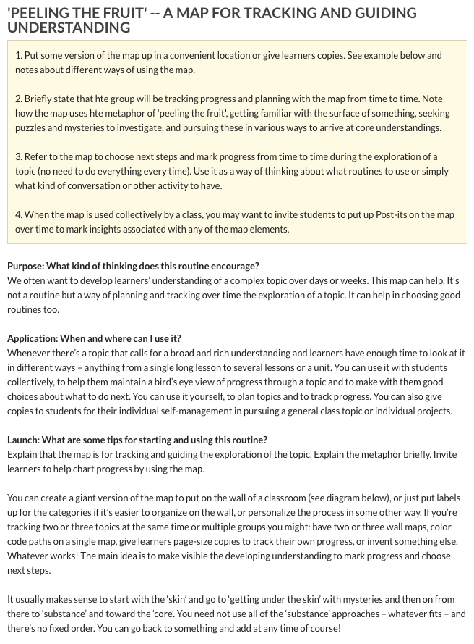
(Harvard Graduate School of Education, 2017)
Notes:
Peel the Fruit ACTIVITY: SEE: http://pz.harvard.edu/resources/peel-the-fruit
Divide the group into two teams.
Each team will choose a team leader, “change agents”, and the “active ingredient”
Each team will receive a paper tote bag with a puzzle in it to solve. One will be a simple picture puzzle, the other will be a crossword puzzle. The teams will work on opposite sides of the room, or in an adjacent area where the other group cannot hear or see what they’re solving quite so easily.
The “active ingredient” will be given a Cutie (clementine orange).
The team leader assigns tasks to the “change agents” as related to their puzzle to solve.
Each time a part of the puzzle is solved the “change agent” peels off one piece of the Cutie.
The team who solves their puzzle and peels their Cutie first wins.
Reflection: Share the team building experience with the other team. How did the orange assist your team with keeping track of the puzzle? What visible markers were available to you that were helpful? What strategies were used to time both requirements? Did you refer to the puzzles or the oranges most often to gage how much progress was made? Discuss what worked well and what you might change.

Slide 45
A C T I V I T I E S
{
Five activities that encourage reflective practice for each participating teacher:
BREAKOUT SESSIONS
Visible Learning, in Caiman Hall (1:15 minutes) (Appendix A) ACTIVITY: Peel the Fruit
Artful Thinking, in the VAPA Room (1:15 minutes) (Appendix B) ACTIVITY: See-Think-Wonder
Layered Learning Comes Alive (60 minutes) (Appendix C) ACTIVITY: SEE–THINK–WONDER–KNOW?
Four Keys to Coaching Conversations with Confidence (60 minutes) (Appendix D)
Coaching 1-2-3 Closing Activity
appendix
Notes:
APPENDIX B: Artful Thinking

Slide 46
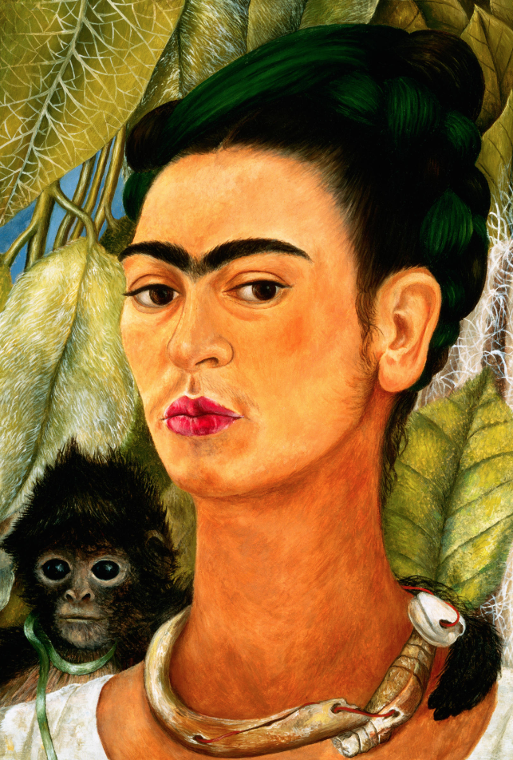
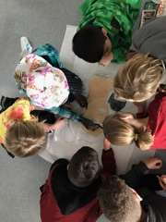
(Corbis, 2017)
Notes:
APPENDIX B: Artful Thinking
Frida Kahlo often included monkeys into her paintings, as in this 1938 self-portrait, portraying them as friendly protective pets. Photo: Albright-Knox Gallery/CORBIS
ACTIVITY: SEE-WONDER-THINK https://www.teachingchannel.org/videos/thinking-routine-getty
Each student will examine the projected self-portrait done by Frida Kahlo projected on the screen. *Please see the following page for painting reference. STEP 1: What do I SEE? Look closely, create a thoughtful interpretation for 60 seconds. Identify small and big details. Write down three things that you saw on your graphic organizer.
STEP 2: What do I WONDER?
Look at things that they can see, and wonder about things that they cannot see.
(e.g., “I wonder if the bones on Ms. Kahlo’s necklace came from an animal?”)
STEP 3: What do I THINK?
This is the last phase and it gives students the opportunity to make interpretations.
What can you infer from your observations?
At this point students look to questions from the “wonder” section and look for visual evidence to answer their own questions.
Sometimes they will be able to come up with a possible answer to their own question, and then other times they will not find what they need from visual evidence. At this point students may look to each other, or work independently, to investigate further.
*Please refer to slide 18 for the graphic organizer for this activity.

Slide 47
A C T I V I T I E S
{
Five activities that encourage reflective practice for each participating teacher:
BREAKOUT SESSIONS
Visible Learning, in Caiman Hall (1:15 minutes) (Appendix A) ACTIVITY: Peel the Fruit
Artful Thinking, in the VAPA Room (1:15 minutes) (Appendix B) ACTIVITY: See-Think-Wonder
Layered Learning Comes Alive, (60 minutes) (Appendix C) ACTIVITY: SEE–THINK–WONDER–KNOW?
Four Keys to Coaching Conversations with Confidence (60 minutes) (Appendix D)
Coaching 1-2-3 Closing Activity
appendix
Notes:
APPENDIX C: Layered Learning Comes Alive
Analyze Integrated Lessons to understand essential design components to meet the needs of all students by including multiple modalities and Intelligences as aligned to multiple subjects’ CA State Standards and Common Core State Standards SEE: http://www.ascd.org/publications/books/61189156/chapters/Integrating-Thinking-and-Learning-Skills-Across-the-Curriculum.aspx
What exactly is integrated curriculum? In its simplest conception, it is about making connections– connections to real life, across disciplines… skill-based and knowledge-based (Drake & Burns, 2017).
Interdisciplinary approaches vary including a fusion of skills, knowledge, and even attitudes into the approved Common Core and State Standards. Learning centers are often put into practice within classrooms at all grade levels. These may include multiple disciplines united in theme, and offer students various ways to examine a concept or topic. In higher grades students generally have subject area experts who facilitate inquiry-based learning. Through Integrated Curriculum students often experience multiple subjects (e.g., Literature, History, Science, and Art) working within a theme-based unit of study. Multi-age groups working in parallel become interconnected through performance tasks and hands-on learning experiences. Teachers who facilitate these types of learning activities often observe multiple benefits, including:
Students exhibited excellent on-task behavior.
Students worked collaboratively.
Multiage teams formed within the multiage classes.
Students were engrossed both as presenters and as the audience for the half-day performance task presentations.
Students used a wide range of presentation products, such as video, debate, sculpture, and so on.
Students demonstrated depth of understanding of topics as a result of their sustained interest around various questions (e.g., Are the Olympics relevant today? Does the Olympic creed stand the test of time?).
Fewer recess problems occurred during this two-week period.
Teachers enjoyed the process and the results. (Drake & Burns, 2017)
Project-Based Learning
Project-based learning engages all students by requiring them to tackle a specific essential question, or problem. Steps to selecting topics for project-based learning may spring forward from the State Standards, and/or the CCSS’s, and blend with students interests and local resources. The teacher becomes the facilitator, guiding students to generate questions and explore deeper on what they already know about a given subject or topic. The teacher also provides resources for the students with opportunities to solve the essential question in a variety of ways including but not limited to writing, history, math, science, and the arts.

Slide 48
See , Think, Wonder: KNOW
Reflection: EVALUATE
What did I do differently the second time doing this activity with a group instead of independently?
Did I challenge myself or did I choose an image that I already know quite a bit about?
Why or why not?
Did I take a leadership role?
Did I learn anything new as a result of doing this exercise?
Am I more comfortable working independently or within a team?
How will this activity help me to collaborate better?
Notes:
ACTIVITY: SEE–THINK–WONDER–KNOW?
Working in pairs or small groups
EXTENSION of See-Wonder-Think activity as integrated subject lesson using teams, technology, and oral presentations (CCSS’s Speaking and Listening Goals).
STEP 1: What do I SEE?
Look closely, create a thoughtful interpretation of ONE image per group of 2 or 4 for 60 seconds. *For added challenge choose an image that you know less about. Identify small and big details. Write down three things that you saw on your graphic organizer.
STEP 2: What do I WONDER?
Look at things that they can see, and wonder about things that they cannot see.
(e.g., “I wonder where in the world this is? I wonder when it was built…who built it?”)
STEP 3: What do I THINK?
This is NOT the last phase and it gives students the opportunity to make interpretations.
What can you infer from your observations? Switch organizers with someone on your team. At this point students look to questions from the “wonder” section and look for visual evidence to answer each other’s questions.
STEP 4: What do we KNOW?
Here’s the EXTENSION: At this point students may look to each other, or work independently to investigate further. Respond to the “5 w’s & an H” questions: Who, What, Where, When, Why, & How. One person on the team may be the researcher, while another writes, it’s up to the students to come up with a plan together.
STEP 5: Where are we NOW? One person per group will BLINDLY choose a map from the group of maps that are printed out and face down on the table. This person needs to match the map an image that another team picked. The person with the map will now listen to the new team tell her (or him) about the wonder that is built there. Added challenge: The “Map Person” explains this new information to the whole group. This continues until all of the Wonders of the World have been shared with each other.
Reflection: EVALUATE -- What did I do differently the second time doing this activity with a group instead of independently? Did I challenge myself or did I choose an image that I already know quite a bit about? Why or why not? Did I take a leadership role? Did I learn anything new as a result of doing this exercise? Am I more comfortable working independently or within a team? How will this activity help me to collaborate better?

Slide 49
A C T I V I T I E S
{
Five activities that encourage reflective practice for each participating teacher:
BREAKOUT SESSIONS
Visible Learning, in Caiman Hall (1:15 minutes) (Appendix A) ACTIVITY: Peel the Fruit
Artful Thinking, in the VAPA Room (1:15 minutes) (Appendix B) ACTIVITY: See-Think-Wonder
Layered Learning Comes Alive (60 minutes) (Appendix C) ACTIVITY: SEE–THINK–WONDER–KNOW?
Four Keys to Coaching Conversations with Confidence, (60 minutes) (Appendix D)
Coaching 1-2-3 Closing Activity
appendix
Notes:
APPENDIX D: Four Keys to Coaching Conversations with Confidence

Slide 50
Coaching Conversations with Confidence
Important Closing Thoughts:
Focusing on one goal at a time is key to effective growth and sustainable performance.
Choose no more than three to four growth goals per year.
Don’t try to work on all three goals at the same time. (Marzano Research, 2017)
Notes:
APPENDIX D: Four Keys to Coaching Conversations with Confidence (continued)
Four Keys to Coaching Conversations with Confidence Improve observational feedback and communication to improve school performance during coach-teacher conversations by using four types of conversations: Reflective, Facilitating, Coaching, and Directing. (Marzano, 2017)
According to Marzano (2017)
Coaches can help teachers facilitate discussions to improve school performance during coach-teacher conversations by using one of the four types of conversations:
Reflective conversations are designed to help teachers recognize the beliefs and behaviors that affect their classroom practice.
Facilitating conversations are designed to help teachers set goals.
Coaching conversations are designed to move teachers closer to accomplishing their goals.
Directing conversations are designed to prompt a teacher to action.
Teachers’ progress on specific elements of teaching should be measured and tracked using a developmental scale.
At the Not Using (0) level, a teacher does not know about strategies or behaviors associated with an element of effective teaching. For example, a teacher at this level might not know how to help students elaborate on new information.
At the Beginning (1) level, a teacher uses strategies associated with an element of effective teaching, but uses them incorrectly. For example, a teacher at this level might try to ask inferential questions, but do it incorrectly or leave out important parts of the strategy.
At the Developing (2) level, a teacher uses strategies correctly, but doesn't monitor students' reactions to those strategies. At the Applying (3) level, the teacher monitors students' reactions to ensure that the strategy is having the desired effects. At the Innovating (4) level, the teacher integrates multiple strategies or adapts strategies to meet students’ unique needs or situations.
One of the first tasks in the coaching process is for the teacher to conduct a self-audit. This self-audit consists of four steps: (1) completing a profile, (2) selecting growth goals, (3) verifying the teacher’s selections, and (4) writing growth goals.
Once a teacher has selected specific areas on which to focus, the coach should verify the teacher's selections. One way a coach does this is by observing the teacher during one or more sessions. A better appraisal may be obtained if the coach and teacher jointly examine a video recording of the teacher. When examining a video, the coach and the teacher should watch for specific strategies that the teacher is using correctly and effectively, strategies that the teacher is attempting to use but is executing incorrectly or with parts missing, and strategies that a teacher could have used but did not (pp. 24–29).
One of the ways a coach can identify errors or omissions in a teacher's use of a strategy is by examining its effect on students.
For example, a coach may think that the teacher is correctly executing the chuck processing strategy until the coach begins to ask students to describe their predictions about new information. Upon discovering that the students cannot describe their predictions, the coach might reexamine the teacher's execution of the third part of the strategy and realize that he or she is not giving them enough time or direction to make meaningful predictions (p. 62).
Effective feedback should be timely and specific. A coach can provide feedback in several ways: informal verbal, informal written, formal verbal, and formal written.
Informal feedback is usually brief, such as stopping by a classroom to give a quick
positive comment about an observation earlier in the day. Formal feedback is more extensive and is detailed and specific about what the teacher did that was effective and what the teacher did that was not effective or needs to be adjusted. Formal written feedback might be given in a longer email or by memo. The coach normally retains a copy of formal written feedback to inform future discussions (pp. 217–218).
A coach and a teacher must establish a set of shared understandings and conditions that will drive the rest of their interactions.
Four practices that are essential for an effective coaching relationship are: (1) establishing a model of effective teaching, (2) using a scale to measure teachers’ progress, (3) conducting a self-audit, and (4) establishing a coaching perspective (p. 19). (Marzano Research, 2017)
Important Closing Thoughts:
Focusing on one goal at a time is key to effective growth and sustainable performance.
Choose no more than three to four growth goals per year.
Don’t try to work on all three goals at the same time. (Marzano Research, 2017)

Slide 51
A C T I V I T I E S
{
Five activities that encourage reflective practice for each participating teacher:
BREAKOUT SESSIONS
Visible Learning, in Caiman Hall (1:15 minutes) (Appendix A) ACTIVITY: Peel the Fruit
Artful Thinking, in the VAPA Room (1:15 minutes) (Appendix B) ACTIVITY: See-Think-Wonder
Layered Learning Comes Alive (60 minutes) (Appendix C) ACTIVITY: SEE–THINK–WONDER–KNOW?
Four Keys to Coaching Conversations with Confidence (60 minutes) (Appendix D)
Coaching 1-2-3,Closing Activity
appendix
Notes:
CLOSING ACTIVITY: Coaching 1-2-3

Slide 52
Coaching 1-2-3
Bonus question: What do you need most in order to succeed?
Reflection: Please write the question that you believe is the most powerful change agent to your practices today on a Post-It and leave it on the door as you exit.
Notes:
CLOSING ACTIVITY: Coaching 1-2-3 (continued)
Just for fun, how would you organize the following questions into the three lists: Curious Questions, Clarifying Questions, and Possibility Questions. Here’s an fun activity to get your creativity connected to self-coaching. First, use a yellow, green, or blue highlighter to organize these prompts into the categories numbered and color coded above. Next, stand up and choose a new partner to brainstorm with for about five minutes. Finally, choose one of these questions and consider how it directly relates to your teaching practice today. How will you use this question to drive positive change beginning tomorrow morning? (*Please note: Some of these prompts work more naturally than others in this activity.)
How have you grown this month?
What did you learn?
What did your students learn?
How do you know this?
What will it look like when (insert goal here) happens?
What will it sound like when (insert goal here) happens?
What will it feel like when (insert goal here) happens?
Who else will benefit?
Is this the problem or the solution?
How would you like it to be?
What does this mean to you?
How can you find out?
Is this giving you energy or draining your energy?
What will really make the biggest difference here?
What’s the benefit of this problem (aka. “silver lining”)?
Have you solved challenges like this before?
Will this strategy move all learning forward?
What’s the first step you need to take to differentiate instruction?
How would your students’ behavior transform if you changed (insert behavior here) right now?
How can you improve (insert behavior or practice here) today, so it adds value to more people?
How could you direct this conversation so it empowers more active responses?
Which change could you take that would make the biggest difference, right now?
Do you need to drive or delegate this?
How can you utilize this “stretch” so that it becomes your “strength”?
Who will you include to partner with this?
Do your current practices with (insert behavior or practice here) fully support all learners?
Bonus question: What do you need most in order to succeed?
Reflection: Please write the question that you believe is the most powerful change agent to your practices today on a Post-It and leave it on the door as you exit.
Thank you for attending and thank you for making every day special for our kids!
------------------------------------------------------------------------------------------------------------------------------------------------------------------------------------------------------------------------------------------------------------------------------------
INSTRUCTIONAL LEADERSHIP GOALS ACCOMPLISHED:
CAPE 5: Promoting Implementation of K-12 Standards, Pedagogical Skills, Effective Instructional Practices and Student Assessments for Content Instruction
CAPE 6: Evaluating, Analyzing, and Providing Feedback on the Effectiveness of Classroom Instruction to Promote Student Learning and Teacher Professional Growth
CAPE 7: Demonstrating Understanding of the School and Community Context, Including the Instructional Implications of Cultural/Linguistic, Socioeconomic, and Political Factors
CAPE 8: Communicating With the School Community about School-wide Outcomes Data and Improvement Goals

