Slide 1
Notes:
ADMN532_Wk5_TeamB_TeacherInductionPresentation_FINAL
Induction is the method Preliminary Credential holders must use to obtain a Professional Clear Credential. Induction replaces the former format of additional university coursework. It is work-embedded professional development designed to apply and extend the skills and knowledge learned in the preliminary program. Teachers who have earned a preliminary credential must complete the teacher Induction Program and demonstrate growth toward the CSTPs over a two-year period while enrolled in the program.
Beginning in 2017-18, participating teachers will co-create an Individualized Learning Plan (ILP) centered on self-selected goals designed to demonstrate growth in the CSTPs.
(Fairfield-Suisun Unified School District, 2017)

Slide 2
Notes:
The Teacher Induction Program provides job embedded professional development that moves one’s teaching practice forward from pre-service experiences. Each participating teacher meets at an agreed upon day with a highly skilled Mentor Teacher who is assigned to guide and support professional growth through the two-year Induction Program.
This collaborative relationship provides support and guidance to teachers as they undertake the complex job of serving the diverse needs of their students. Observation and feedback, coaching, demonstration lessons, and planning are a few of the ways that consulting Mentor Teachers provide support for new teachers (Fairfield-Suisun Unified School District, 2017).
The plan for Induction includes a focus on the ongoing process of professional learning communities (PLCs) and the five dimensions of teaching and learning: purpose, student engagement, curriculum and pedagogy, assessment for student learning, and classroom environment and culture.
The four members of Team B will each provide notes from interviews conducted at their individual school sites and/or districts. In summary, a comparison will be provided to analyze similarities of how each school manages the beginning teacher Induction Process.
Overview of points to be covered herein:
How are principles of adult learning theory utilized in the design and implementation of professional development?
How is new teacher induction organized at the district and school-site levels to meet new teacher and student learning needs?
How are data organized to identify instructional and PD needs of the whole faculty and staff?

Slide 3
Notes:
According to Knowles’ (1984), adult learners need to:
be involved in the planning and evaluation of their instruction;
learn through experience, including mistakes, as the basis for understanding;
be interested in the relevance and impact that the learning will make on their lives and/or profession; and
be involved in problem-centered work, rather than content oriented tasks.
Induction is the method Preliminary Credential holders must use to obtain a Professional Clear Credential. Induction replaces the former format of additional university coursework. It is work-embedded professional development designed to apply and extend the skills and knowledge learned in the preliminary program. Teachers who have earned a preliminary credential must complete the teacher Induction Program and demonstrate growth toward the CSTPs over a two-year period while enrolled in the program. Beginning in 2017-18, participating teachers will co-create an Individualized Learning Plan (ILP) centered on self-selected goals designed to demonstrate growth in the CSTPs.
The consulting Mentor Teacher and Participating Teacher work together to develop and refine strong teaching skills. Teachers look at evidence when reflecting on their practice, as it relates to each of the California Standards for the Teaching Profession (CSTP). (Fairfield-Suisun Unified School District, 2017)
Knowles, M. (1984). Andragogy in action. San Francisco: Jossey-Bass

Slide 4
Notes:
For example, learning activities should commence with data analysis for participants to undertake a problem-solution learning activity. Data Analysis should include multiple forms of student progress data for English Learners (CELDT, DIBELS, GRADES) and collaborative reflective activities in which patterns of a school’s, grade levels’, and student groups’ strengths and weaknesses are identified and further analyzed. Weak areas should be related to grade level specific standards and lessons in which stakeholders collaborate to develop specific plans of action for instructional improvements.
Intentional groupings during Professional Development should be considered for the varying levels of teaching experience of educators at a given school site. However, the facilitator should note that all participants engage in new learning regarding specific teaching practices for ELD instruction no matter the years of teaching experience. Coaching may be present at school sites in various forms and/or levels of participation in relation to the amount of Administrative support and/or non-support including BTSA support for new teachers receiving mentorship.

Slide 5
Notes:
Participants share new learning with stakeholders at the school site through a sustained, site-based Professional Development.
Future learning opportunities are continuously provided for all stakeholders to apply new learning in daily ELD instruction in which observations are made to promote improved instructional practices.
The basis for continued Professional Development is presented as the main means to improving student achievement by equipping EL students will the skills necessary for graduation and continued learning in college and/or university setting.

Slide 6
Notes:
How are principles of adult learning theory utilized in the design and implementation of professional development?
When creating professional development opportunities for teachers it is important to find out what they are interested in learning first. Adult learners must have buy in for any PD to be successful, therefore surveying the staff to see what is of most interest to them (that is also in accordance with the needs of the school) is a first step. Once the topic has been determined it is necessary to state the goal of the PD up front so that the Adult Learners know where the training is leading. The PD should be practical and useful. A successful strategy I have used is to always give the teachers something that they can utilize in their classrooms the very next day with little to no preparation. Giving the teachers an opportunity to collaborate during the course of the PD is also important. Teachers usually do not like to be lectured to, therefore providing opportunities to share during the presentation or workshop can allow them to process what is being taught, while giving them the time to talk to each other (Adler, 2017).
Mammoth Unified School District has partnered with Focus Schools, who are educational consultants which provide support to the school staff through adult learning theory (andragogy) framework. This allows the district to provide sustained professional development for self-directed learners that is job-embedded in the staff at Mammoth Unified School District (Rinaldi, 2017).
How is new teacher induction organized at the district and school-site levels to meet new teacher and student learning needs?
Induction is organized by the County Office of Education. The COE trains the Induction Coaches and assigns coaches to teachers, trying to link coaches who have had the same teaching experience as the teachers they are working with. The coaches are supposed to meet with their candidates several times during the course of each month and observe their teaching frequently. The coaches themselves receive training from the County Induction Coordinator four times during the year. There is also a log required to be completed by the coaches and by the Induction candidates throughout the program. The full Induction program is two years long, and a teaching candidate must successfully complete the program in order to become fully credentialed (Adler, 2017).
Stacey describes how Mono County Department of Education provides the CA-BSTA program to Mammoth Unified School District.
How are data organized to identify instructional and PD needs of the whole faculty and staff?
Determinations of the instructional/PD needs of the faculty/staff are made through a variety of ways. First of all, the new CA Dashboard is a primary source of information. The Dashboard illuminates areas (instructional and climate) of need through a color coded system based upon data that is collected by the state. Schools/districts who do not show improvement from the lowest level after a two year period required technical assistance and this would provide information to indicate PD is needed in that/those given area/s. Staff surveys of various topics is another way data is collected to determine subjects for PD. The District Office will also make recommendations or develop district priorities that the school site must follow and provide PD in that area (Adler, 2017).
Mammoth Unified District’s schools used disaggregated student data to identify instructional and PD needs. For example, the high school identified evidence based writing as the instructional need while the middle school identified critical thinking. The data used to organized and identify instructional needs is also used set the school focus and aligns to the school vision (Rinaldi, 2017).

Slide 7
Notes:
The State of California has designed a website that helps school communities access important information about their local schools and districts. The California School Dashboard features reports that are easy to read on multiple measures of school success. These reports includes test scores, graduation rates, English Learner progress and suspension rates (Dublin School District, 2017).

Slide 8
Notes:
Judith Sevilla’s interview with Christi Granado, Principal at Olivia Nieto-Herrera Elementary on May 26, 2017:
How are principles of adult learning theory utilized in the design and implementation of professional development?
As we look towards the professional development was before entering the site, you engage where you want your staff to be at the end of the year. Our focus this year is on formative assessment and how to use the gradual release model. In order to ensure staff comprehends, integrates and focus, we systematically organize the year long professional development in conjunction to the district recommendations as a school district in conjunction to the adult learning theory.
How is new teacher induction organized at the district and school-site levels to meet new teacher and student learning needs?
Our district new teacher induction program provides support as a district by establishing professional development in content area, has a mentor teacher that works in the same site to support the new teacher. The mentor and new teacher collaborate, plan and support the new learning and ensures student learning needs, classroom management and lesson delivery through observations, informal observations, probing questions from the mentor to the new teacher and facilitating in the planning of lessons.
How are data organized to identify instructional and PD needs of the whole faculty and staff?
First we establish a year long school goals, professional development year long focus and create a timeframe of when data is collected, the type of data needed to collect, the validity of common assessments and content specific data. We meet with teachers every quarter to determine next steps within the classroom. We also use the data to monitor and adjust the year long focus and professional development, and teachers identifies the five students each teacher will track, focus and monitor growth who are near proficiency.

Slide 9
Notes:
Image: James-Ward, C., Fisher, D., Frey, N., & Lapp, D. (2013). Using data to focus instructional improvement. Alexandria, VA: ASCD.

Slide 10
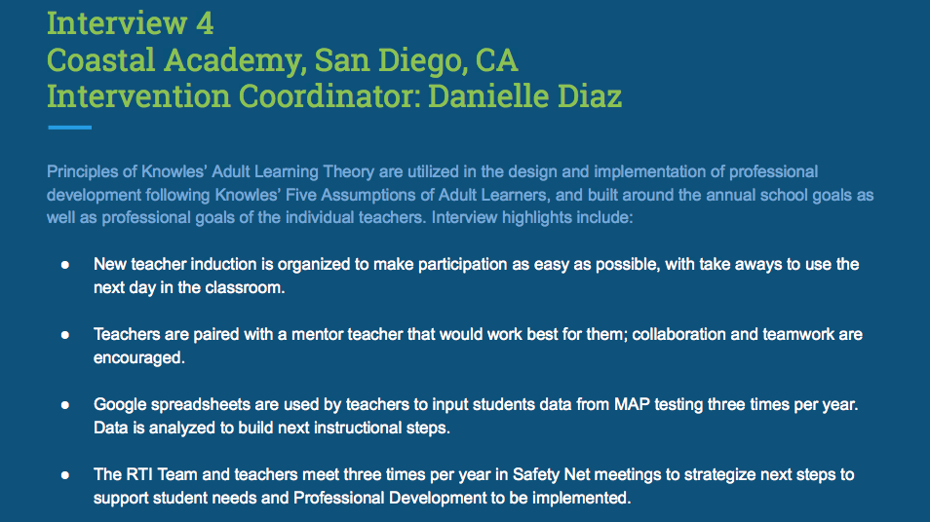
Notes:
Diana Stein’s interview with Danielle Diaz, Intervention Coordinator at The Coastal Academy May 25, 2017:
How are principles of adult learning theory utilized in the design and implementation of professional development?
Professional development is designed and implemented around what our school goals are for the year, along with what teachers say that they need/want to learn more about. It is implemented in half day sessions, usually not after a teaching day so that teachers are fresh and ready to participate. We try to make the learning interactive and valuable in that we want to the teachers to relate it to what they are doing with students. We encourage teachers to have a take away from the learning to use in the classroom the next day.
How is new teacher induction organized at the district and school-site levels to meet new teacher and student learning needs?
New teacher induction is organized to make it as easy as possible on the teacher to participate in. Teachers are paired with a mentor that would work best for them. Teachers are encouraged to meet as a group to dialogue and bounce ideas off one another.
How are data organized to identify instructional and PD needs of the whole faculty and staff?
At Coastal we have a Google spreadsheet that teachers input student data on from MAP testing. The RTI team and teachers meet three times a year in safety net meetings to discuss overall data and student needs. Based on what is discussed in safety net and what the data is showing, professional development is brainstormed and then implemented.

Slide 11
Notes:
Principles of adult learning theory are utilized in the design and implementation of professional development following Knowles’ Five Assumptions of Adult Learners:
Knowles’ Five Assumptions Of Adult Learners
In 1980, Knowles made four assumptions about the characteristics of adult learners (andragogy) that are different from the assumptions about child learners (pedagogy). In 1984, Knowles added the fifth assumption.
Self-concept
As a person matures his/her self concept moves from one of being a dependent personality toward one of being a self-directed human being
Adult Learner Experience
As a person matures he/she accumulates a growing reservoir of experience that becomes an increasing resource for learning.
Readiness to Learn
As a person matures his/her readiness to learn becomes oriented increasingly to the developmental tasks of his/her social roles.
Orientation to Learning
As a person matures his/her time perspective changes from one of postponed application of knowledge to immediacy of application, and accordingly his/her orientation toward learning shifts from one of subject- centeredness to one of problem centeredness.
Motivation to Learn
As a person matures the motivation to learn is internal (Knowles 1984:12).
Knowles, M. (1984). Andragogy in action. San Francisco: Jossey-Bass.

Slide 12
Notes:
Understanding the role of adult learning theory in organizing professional development for general teachers is of key importance.
The motivation to learn plays a critical role.
For example, Induction is sometimes seen as just another set of “hoops to jump through.” Taking the time to write specific and measureable goals, with attainable targets, with the Mentor/Coach that will be meaningful, and perhaps pivotal, to reaching practices makes the learning experience not only relevant but potentially pivotal.)
When the relevance matches the listed criterion for learning the rigor has the potential to increase exponentially.

Slide 13
Notes:
The roles that identify the factors that connect organizational goals and teacher selection, placement, and ongoing training beyond the two-year Beginning Teacher Support and Assessment (BSTA) requirement include consulting by Mentor teachers and Intervention Specialists that support in a variety of ways. Some of these include:
Coaching
Formal and informal observations
Debriefing a lesson
Analysis of student work
Problem solving
Sharing of resources and materials
Demonstration lessons
Co-teaching
Arranging a site visitation to a veteran teacher’s classroom
Creating and gathering evidence of Induction Standards
(Fairfield-Suisun Unified School District, 2017)

Slide 14
Notes:
Compare & Contrast collected information.
Within this presentation we have noted the similarities of the Induction method for Preliminary Credential holders to obtain a Professional Clear Credential varies slightly from school to school. In summary, here are some key points to compare and contrast the work-embedded professional development that provides evidence of the skills and knowledge learned in the preliminary program.
The learning activities listed in Interview One focused on data collection and analysis for participants to undertake a problem-solution learning activity. Data Analysis included multiple forms of student progress data for English Learners (CELDT, DIBELS, GRADES) and collaborative reflective activities in which patterns of a school’s, grade levels’, and student groups’ strengths and weaknesses are identified and further analyzed. Weak areas should be related to grade level specific standards and lessons in which stakeholders collaborate to develop specific plans of action for instructional improvements (Choi, 2017).
In Interview Two we examined Mammoth Unified District’s schools used disaggregated student data to identify instructional and PD needs. For example, the high school identified evidence based writing as the instructional need while the middle school identified critical thinking. The data used to organized and identify instructional needs is also used set the school focus and aligns to the school vision (Rinaldi, 2017).
Interview Three established how year-long school goals set a target for professional development as a year-long focus for each teacher candidate. A time frame is created of when data will be collected, the type of data needed to be collected is identified, and the validity of common assessments and content specific data are agreed upon. Teachers meet with their Induction Advisor every quarter to determine next steps within the classroom. Data is utilized to monitor and adjust the year long focus, and aligned to professional development. The teacher candidate identifies five students who are near proficiency to track, focus and monitor growth (Sevilla, 2017).
Interview Four highlights included that Professional Development is designed and implemented around what the school goals are for the year, along with what teachers say that they need/want to learn more about. It is implemented in half day sessions, usually not after a teaching day so that teachers are fresh and ready to participate. The trainers and Instructional Coaches try to make the learning interactive and valuable, in that they want the teachers to relate it to what they are doing inside the classroom daily, and have take-aways that are relevant and timely to implement right away.
The Teacher Induction process can be a meaningful and insightful experience when meaningful and measureable goals are set and supported by ongoing dialog and partnering between the Teacher Candidate and the Induction Advisor. In conclusion, all four of the school’s practices identified herein utilize the five assumptions of adult learning (andragogy) to increase student progress and build teaching capacity to drive school wide learning progress forward for all learners. In all cases, the plan for Induction includes a focus on the ongoing process of professional learning communities (PLCs) and the five dimensions of teaching and learning: purpose, student engagement, curriculum and pedagogy, assessment for student learning, and classroom environment and culture.

Slide 15
