Slide 1
Parent Involvement Assessment
Cristina Caballero, Kelley Jayne,
Jordan B. Smith, Jr., Diana Stein
ADMIN/530
University of Phoenix
Debra Dinowitz
March 6, 2017
January 23, 201

Slide 2
Needs Assessment?
Please Click on the link below to access the needs assessment.
https://goo.gl/forms/tMglEE64fnfx8STQ2
The Parent Involvement Needs Assessment is a way for the school to assess the needs of our parents, and to prioritize parent involvement in our schools.
(Youngston, 2016)
Notes:
Our team administered the Parent Involvement Needs Assessment to a select group of parents at our three different sites. In the following slides we will share our data, the similarities, and the differences between the three sites.

Slide 3
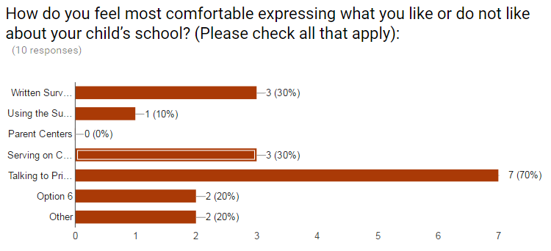
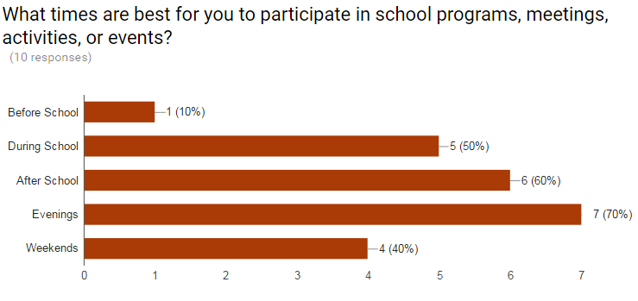
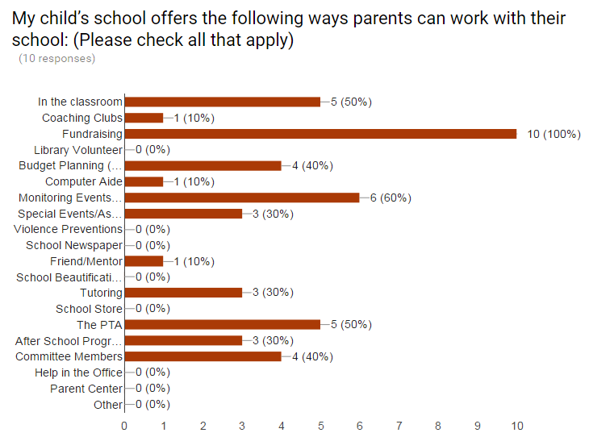
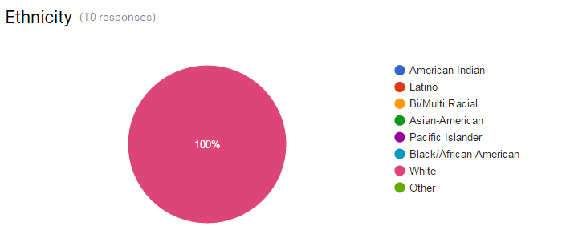
Kelley’s Analysis of Data
Notes:
The results of Mammoth High School’s Parent Involvement Needs Assessment:
100% of the parents feel welcomed and the staff, teachers, counselors and principals are courteous, respectful, and helpful. 63% of the parents think that the school sometimes does a good job letting them know how their child is doing in school. 90% of the parents preferred to be contacted by email, and 63% of them preferred to be called about how their child is doing in school. 90% of the parents responded report cards and progress reports, and assignment calendars fit their needs on how their students are doing in school. All the parents would like to see the school offer workshops in how to motivate your child, goals setting, and how to prepare for state test. As far as information from the school to help parents with their students 27% are satisfied most of the time, and 37% are not, and 37% are satisfied. The majority (63%) of parents fill most comfortable talking to the principal, counselors or teachers when a problem arises. 72% of the parents would like to participate in decision making at the school. Most parents 72% can help out at the school during the evening. 72% of the parents work outside the home and are white.
My main concern with the new information received from this needs assessment is 63% of parents are not satisfied with the information they receive about how their student is doing in school.

Slide 4
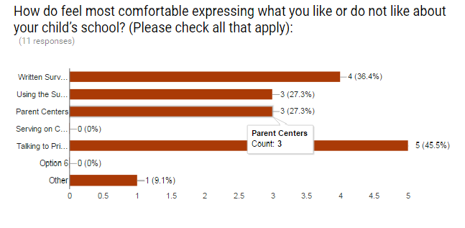
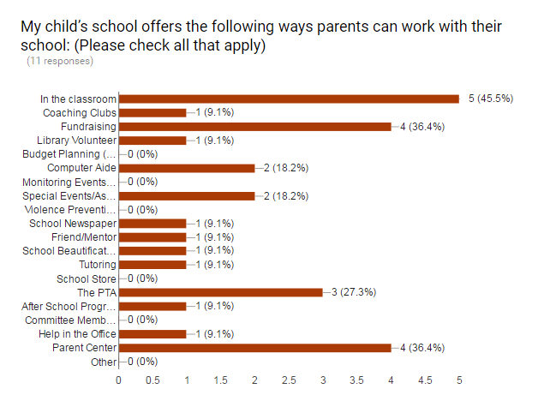
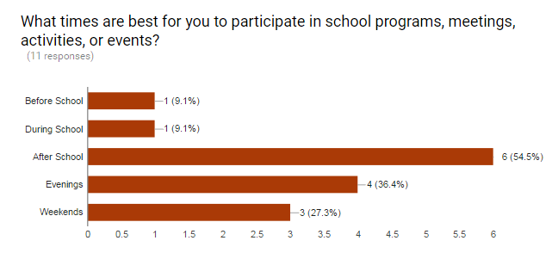
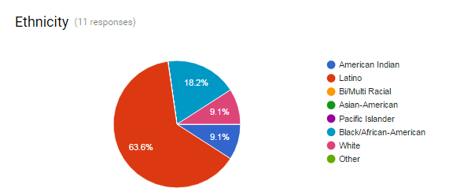
Cristina’s Analysis of Data
Notes:
The results of the data collection from Dominguez High School (Parent/Guardian Ages - 28 - 76) reveals the following:
Most parents prefer responding to surveys to voice their opinion or speak to the principal concerning issues at the school. 100% of the participants feel welcome by the administrator,staff and teachers. 65% feel welcome by the office staff. The best ways to reach parents about their children is a call home (72.8%), email (54.5%), and note home (34.2%). The school has adequate procedures (92.3%) to address parent concerns, questions, or complaints. 23.6% attend school board meetings. They request information on health, discipline, and drug/alcohol. 47.5% are satisfied with the information received from school. 84.6% feel that the amount of homework is reasonable. 38.5% of parents participate in the PTA, 34.4. % volunteer in the classroom, and 30% wish to volunteer in the library. The best times to reach parents are after school, evenings, and weekends. The majority were in grades 9-12. 90.9% of the children attend a school in their neighborhood. 90.9% of parents work outside the home. The dominant ethnic group is Latino 63.6%. One positive aspect of the school is that the school has people that speak different language to help the majority of the population of the school.

Slide 5
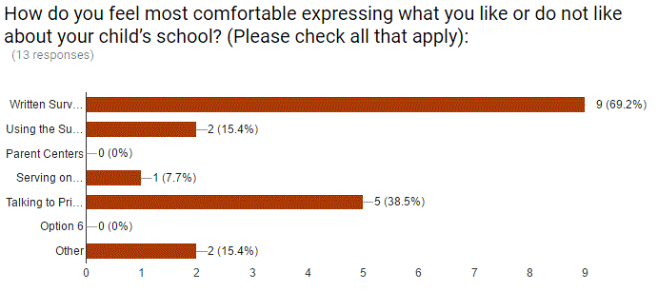
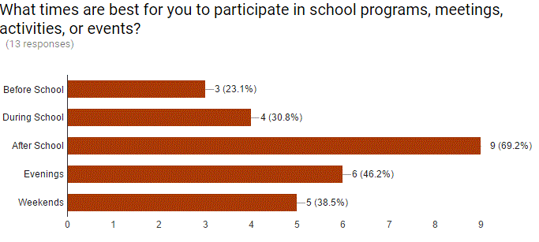
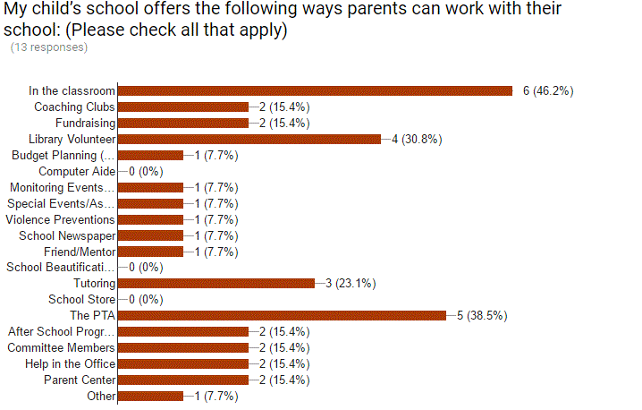
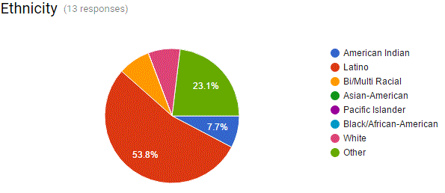
Jordan’s Analysis of Data
Notes:
The results of the data collection from San Jacinto Adult Education (Parent/Guardian Ages - 23 - 58) reveals the following:
Most parents prefer responding to surveys to voice their opinion or speak to the principal concerning issues at the school. 100% of the participants feel welcome by the administrator, counselors, staff and teachers. 85% feel welcome by the office staff. The best ways to reach parents about their children is a note to home (61.5%), email (61.5%), and telephone (69.2%). Most parents want communications between parents and teacher either in person or on the telephone. Some children have experienced discrimination in their school. The school has adequate procedures (92.3%) to address parent concerns, questions, or complaints. 53.8% attend school board meetings. They request information on health, discipline, and drug/alcohol. 92.3% of parents want help on how to prepare their children for the state test, homework, motivation, setting goals, and family reading. 61.5% are satisfied with the information received from school. 84.6% feel that the amount of homework is reasonable. 38.5% of parents participate in the PTA, 46.2 % volunteer in the classroom, and 30% wish to volunteer in the library. The best times to reach parents are after school, evenings, and weekends. The respondents had children in grades 3-12. The majority were in grades 9-12. 92.3% of the children attend a school in their neighborhood. 69.2% of parents work outside the home. The dominant ethnic group is Latino 53.6%. A major area of concern is that only 61.5% of parents are satisfied with the information they get from their school.

Slide 6
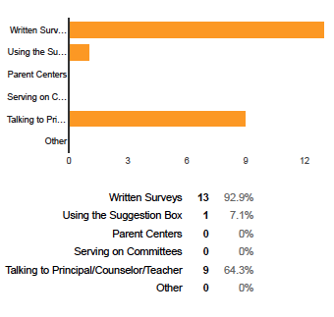
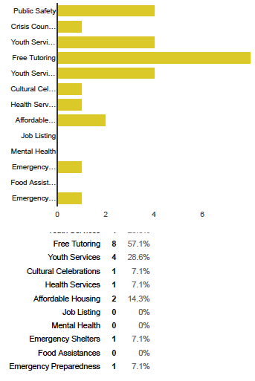
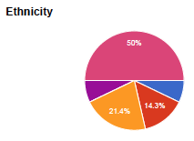
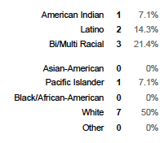
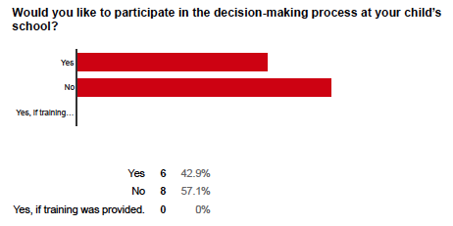
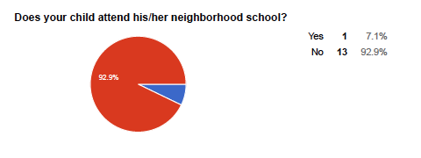
Diana’s Analysis of Data
Notes:
The results of the data collection for The Classical Academies, Vista (TK-8 homeschool hybrid charter school) reveals the following:
Most parents prefer responding to surveys to voice their opinion or speak to the principal concerning issues at the school. 100% of the participants feel welcome by the administrator, counselors, staff and teachers. The best ways to reach parents about their children is a telephone call (10.0), letter/note (5.0), and the LMS/website (4.0). Most parents want communications between parents and teacher either in person or on the telephone. None of the children have experienced discrimination in their school. The school has excellent procedures (100.0%) to address parent concerns, questions, or complaints. 14.3% attend school board meetings, but 42.9% would like to participate in decision-making. They request information on parent workshops (78.6%), computer training (14.3%), parent/community (2.0%); parents are equally interested in health, college/career counseling, and vocational counseling (7.1%). 28.6% of parents want help on how to prepare their children for the state test, but feel confident with helping with homework, motivation, setting goals, and family reading. 100.0% are satisfied with the information received from school. 100.0% feel that the amount of homework is reasonable. 100.0% of parents participate in partnering in the education of their child(ren) 3-5 days per week, as well as volunteer in the classroom, and wish to volunteer at special events. The best times to reach parents are during school hours, after school, and evenings. The respondents had children in grades TK-10th at one or more of our seven school sites. The majority of students whose parents participated in the survey are in grades 4th, 5th, and 7th. 92.9% of the children attend a school that is NOT in their neighborhood. 28.6% of parents surveyed at school work outside the home. The dominant ethnic group is White 50.0%.
A major area of concern is that 57.1% of parents would like information about free tutoring, specifically in teaching math to their child(ren). 78.6% of parents responded favorably to the possibility of attending parent workshops. At the present time no free tutoring is available to our students, besides the support that they receive during and after school hours for math and reading intervention. Since a majority of parents are highly motivated to take workshops it would make sense to offer instructional workshops for addressing the areas of concern that data indicates need more support. For example, we also a “Fun with Fractions Fieldtrip” recently. Students and parents were invited to attend for a nominal charge ($5.). A professional presenter created a hands-on workshop for working with fractions in multiple ways, using mixed modalities. The turnout was higher than expected and we will be gathering data to measure the impact of this seminar as directly related to increased content understanding.

Slide 7
Compare & Contrast
1. What elements that were surveyed provided surprising results?
2. When you compared our findings what did you determine our similarities were?
3. What did you see as the most contrasting variable?
4. In what ways could professional development increase positive results to these outcomes?
5. Are parents actively involved in the decision-making at your school sites?
6. If not, do they know that they are invited to attend board meetings?
7. Which service or training are the parents at your school most interested in being part of and why?
Team B’s comparisons reveal that the specific school sites yield similar findings in some areas, and very different ones in what types of training services the Parents desire. In conclusion, principals, teachers, and all staff members need to be available and ready to listen while inviting all stakeholders to actively engage in school wide policies and practices in order to drive necessary momentum and improvement.
Notes:
Compare & Contrast
Team B compared the findings from the four school sites included in the survey. The questions asked that will help to formulate the analysis of results for the school settings:
1. What elements that were surveyed provided surprising results?
Cristina: The element that was surprising was that the parents wanted to be contacted by telephone.
Kelley: I was surprised that most parents wanted teacher/parent meetings. And most parents are not satisfied with the information they receive.
Jordan: That 25% strongly disagree that school staff was courteous, respectful and helpful to parents (Adult Ed) because the school secretary calls students with poor attendance and threatens to drop them from the program.
Diana: I found it surprising that 57.1% of parents would like information about free tutoring, specifically in teaching math to their child(ren).
2. When you compared our findings what did you determine our similarities were?
Cristina: The way in which the parents felt about the schools.
Kelley: I saw that I did not have as many similarities as the rest of the group. I think that is because Mammoth is in a unique setting from the rest.
Jordan: The way parents generally felt about the school
Diana: The survey revealed that at three out of the four schools surveyed, most parents prefer to be communicated with in person. Secondly, that most parents would like to be included in the decision making policies, but most do not attend the board meeting.
3. What did you see as the most contrasting variable?
Cristina: None
Kelley: The most contrasting variable was ethnicity. We have a large Hispanic and white population. I was not able to survey a large sections of our school. Since I was not able to get approval to go through the district, I had to rely on friends
Jordan: Demographics.
Diana: Ethnicity and the type of school models and/or grade levels surveyed.
4. In what ways could professional development increase positive results to these outcomes?
Cristina: Tell teachers to communicate with parents. When communicating don’t do it because of a negative thing that the students did. Call parents and tell them how well their child is doing or something positive about their child.
Kelley: (no response)
Jordan: (no response)
Diana: Parents are interested in being involved in different levels. Most parents surveyed are more interested in being involved for reasons directly related to their own student’s achievement (e.g. math tutoring, leadership development, etc.) versus taking a more active role in the schoolwide policies and programming. Therefore, professional development that connects with Instructional Leadership for parents would be helpful.
5. Are parents actively involved in the decision-making at your school sites?
Cristina: No unless they are on the school site council
Kelley: Yes, At my school site they are actively involved.
Jordan: (no response)
Diana: It varied from school to school surveyed. Some parents were extremely involved on campus, but weren’t interested in or available to get more involved even if training was involved.
6. If not, do they know that they are invited to attend board meetings?
Cristina: No and if they are they don't have time to go.
Kelley: (no response)
Jordan: Demographics
Diana: Yes and no; some parents who knew that they were invited but chose not/were not available to come.
7. Which service or training are the parents at your school most interested in being part of and why?
Cristina: Drug abuse because drug abuse is very prevalent in the community.
Kelley: Youth services and tutoring. I believe they want these two because Mammoth lacks in both.
Jordan: Understanding math acronyms and assessment reports.
Diana: Parents are interested in being involved in different levels. Most parents surveyed are more interested in being involved for reasons directly related to their own student’s achievement (e.g. math tutoring, leadership development, etc.) versus taking a more active role in the schoolwide policies and programming.

Slide 8
Similarities
Most parents feel welcomed by staff and administrators
Most parents prefer survey or written communication to voice their concerns
Most parents would like to see the school offer workshops or request information
Most parents want communications between parents and teacher either in person or on the telephone, with the exception of Mammoth Mountain High School (90% preferred email).
Differences
Ethnic Groups range from a majority of the campus being Latino to 100% being White at another campus, the minority group is African American
Grade Levels ranged from K -12 grade.
At two schools all of the students attend their neighboring school while the other two have students not attending neighboring schools.
100.0% of parents participate in partnering in the education of their child(ren).
Board meeting participations varies from 14.3% to 53.8% between schools
Parent satisfaction of information received from the schools range from 27% to 100%
Notes:
Analysis of the parents surveyed reveals that we are more alike than we are different. Here are the comparative findings from the subsets of data collected:
Mammoth High School: 63% of parents feel comfortable talking to the principal and 72% of parents can help out with school related activities in the evenings.
All the parents would like to see the school offer workshops in how to motivate your child, goals setting, and how to prepare for state test. The dominant ethnic group is White 100%. As far as information from the school to help parents with their students 27% are satisfied most of the time, and 37% are not, and 37% are satisfied.
San Jacinto Adult Education: 99.2% of parents feel more comfortable using written surveys to communication, but most want communication either in written format or over the phone. 38.5% of parents can volunteer with the PTA, 46.2% volunteer in the classroom, and 30% wish to volunteer in the library. The dominant ethnic group is Latino 53.6%.
A major area of concern is that only 61.5% of parents are satisfied with the information they get from their school.
The Classical Academies, Vista (TK-8 homeschool hybrid charter school):
Most parents (64.3) prefer to voice their opinion or speak to the principal or grade level teacher concerning issues at the school. 100.0% are satisfied with the information received from school. 100.0% of parents participate in partnering in the education of their child(ren) 3-5 days per week, as well as volunteer in the classroom, and wish to volunteer at special events. The dominant ethnic group is White 50.0%. A major area of concern is that 57.1% of parents would like information about free tutoring, specifically in teaching math to their child(ren). Presently no free tutoring is available to our students, besides the support that they receive during and after school hours for math and reading intervention. However, 78.6% of parents responded favorably to the possibility of attending parent workshops.

Slide 9
Proposed Rationale for the Differences
According to Leimer, C. c. (2012), “Schools with more democratic collective leadership practices that include parents in influential positions, student achievement is higher.”
Analysis of the combined findings of the four schools compared herein supports the need to prioritize parent involvement to positively influence student success, inside and outside of school.
Parents need to be included and their voices need to be heard.
Engaging all stakeholders in the programming, processes, and procedures unifies the community and helps to make strides in meeting the shared desired goals, aligning the vision.
The differences and similarities between the survey responses are directly aligned to the cultural capital of each group analyzed. For example:
Stakeholders involved in analyzing data and developing each goal vary by district according to the urgency of needs.
Student groups which will be affected range from elementary to adult education.
Data which will be collected to measure student achievement is similar, with varying amounts of accountability placed on high stakes testing by district.
Notes:
Analysis
According to Leimer, C. c. (2012), “Schools with more democratic collective leadership practices that include parents in influential positions, student achievement is higher.”
Analysis of the combined findings of the four schools compared herein supports the need to prioritize parent involvement to positively influence student success, inside and outside of school. Parents surveyed were asked a multitude of questions, but perhaps the most revealing one that measures the climate and The collected information points to the fact that parents need to be included and their voices need to be heard. Engaging all stakeholders in the programming, processes, and procedures unifies the community and helps to make strides in meeting the shared desire goals, aligning the vision.
Bringing together multiple skills and perspectives of all stakeholders allows for richer analyzes and a larger view of institutional issues and provides opportunities for staff and the community at large to learn from each other. When an information-based mode of thinking and working is part of the culture, people reflexively ask questions and search for relevant data before deciding on a new program or developing initiatives (Leimer, 2012).
A point to reflect upon are the differences and similarities between the survey responses as aligned to the cultural capital of each group analyzed. Parents who have higher economic status are more judgemental about the overall performance of the school. In contrast, parents who are less affluent are more active participants at board meetings. For example:
· Stakeholders involved in analyzing data and developing each goal vary by district according to the urgency of needs.
· Student groups which will be affected range from elementary to adult education.
· Data which will be collected to measure student achievement is similar, with varying amounts of accountability placed on high stakes testing by district.

Slide 10
Goals Based To Address Parent Needs
Create a Parental Involvement Plan to include progress monitoring, review, and annual evaluation with the School Site Council and PTA.
Increase the frequency of communications to parents about student progress to parents.
Create a plan to offer Free Tutoring, especially for math, and provide information to parents using multiple methods for facilitating learning across all subject areas.
(Westerlund et al., 2013)
Notes:
The outcome of the needs assessment is to improve student outcomes and to test the climate and culture specifically in regards to school parent relationships. Every school should conduct a needs assessment in the beginning of the year and in the spring of each school year to monitor the progress of improving parental involvement in student outcomes.
“Parental involvement in their children's studies, particularly in terms of academic socialization, has been shown to predict academic achievement, and is thus a candidate modifiable factor influencing life course socioeconomic circumstances” (Westerlund et al., 2013).
“Parental interest in their offspring's studies may have protective effects by decreasing the likelihood of a chain of risk involving low academic achievement, low socioeconomic position and high accumulated physiological stress” (Westerlund et al., 2013).

Slide 11
References
Leimer, C. c. (2012). Organizing for Evidence-Based Decision Making and Improvement. Change, 44(4), 45-51.
doi:10.1080/00091383.2012.691865
Westerlund, H., Gustafsson, P. E., Theorell, T., Janlert, U., & Hammarström, A. (2013).
Parental academic involvement in adolescence, academic achievement over the life
course and allostatic load in middle age: A prospective population-based cohort
study. Journal of Epidemiology and Community Health, 67(6), 508.
doi:http://dx.doi.org/10.1136/jech-2012-202052
Youngston, N. (2016). Survey [Online Image]. Retrieved from http://creative-commons-images.com/handwriting/s/survey.html

